Slide 1
Android
User Interface
Yuliana Setiowati
Rizky Yuniar Hakkun

Slide 2
Outline
Label
Button
Image View and Image Button
EditText
CheckBox
RadioButton

Slide 3
The View Class
The View class represents the basic building block for user interface components.
View is the base class for widgets, which are used to create interactive UI components (buttons, text fields, etc.).
The ViewGroup subclass is the base class for layouts, which are invisible containers that hold other Views (or other ViewGroups) and define their layout properties.

Slide 4
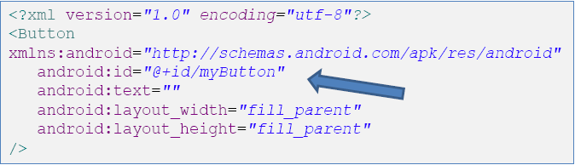
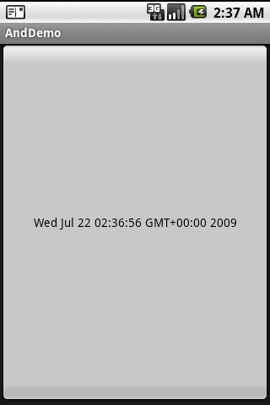
Using @ in XML Layouts
Anything you do want to use in your Java source needs an
android:id=“…”
The convention is to use @+id/nnn as the id value, where the nnn represents your locally-unique name for the widget (eg. @+id/myButton).

Slide 5
Attaching Layouts to Java Code
Assume res/layout/main.xml has been created. This layout could be called by an application using the statement
setContentView(R.layout.main);
Individual widgets, such as myButton could be accessed by the application using the statement findViewByID(...) as in
Button btn= (Button) findViewById(R.id.myButton);
Where R is a class automatically generated to keep track of resources available to the application. In particular R.id... is the collection of widgets defined in the XML layout.

Slide 6
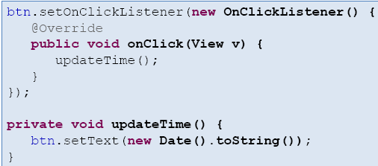
Attaching Layouts to Java Code
Attaching Listeners to the Widgets
The button of our example could now be used, for instance a listener for the click event could be written as:

Slide 7
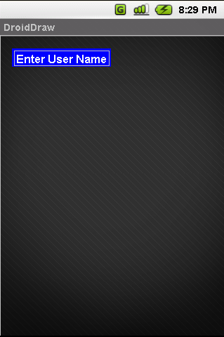
Basic Widgets: Labels
A label is called in android a TextView.
TextViews are typically used to display a caption.
TextViews are not editable, therefore they take no input.

Slide 8
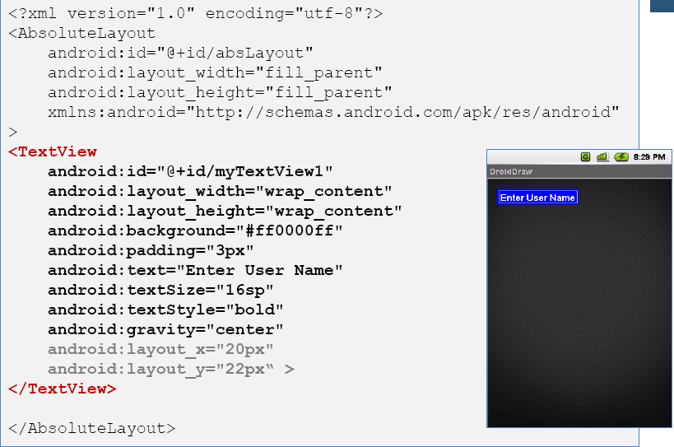
Basic Widgets: Labels

Slide 9
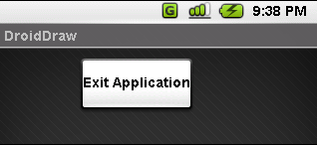
Basic Widgets: Buttons
A Button widget allows the simulation of a clicking action on a GUI.
Button is a subclass of TextView. Therefore formatting a Button’s face is similar to the setting of a TextView.
...
<Button
android:id="@+id/btnExitApp"
android:layout_width="wrap_content"
android:layout_height="wrap_content"
android:padding="10px"
android:layout_marginLeft="5px"
android:text="Exit Application"
android:textSize="16sp"
android:textStyle="bold"
android:gravity="center"
android:layout_gravity="center_horizontal"
>
</Button>

Slide 10
Basic Widgets: Images
ImageView and ImageButton are two Android widgets that allow embedding of images in your applications.
Each widget takes an android:src or android:background attribute (in an XML layout) to specify what picture to use.
Pictures are usually reference a drawable resource.
You can also set the image content based on a URI from a content provider via setImageURI().
ImageButton, is a subclass of ImageView. It adds the standard Button behavior for responding to clickevents.

Slide 11
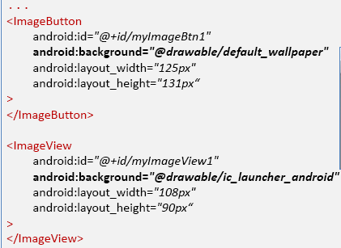
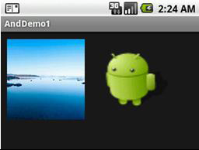
Basic Widgets: Images

Slide 12
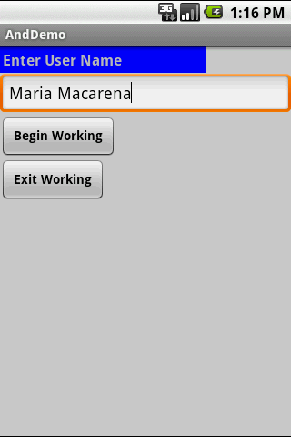
Basic Widgets: EditText
The EditText(or textBox) widget is an extension of TextView that allows updates.
The control configures itself to be editable.
Important Java methods are: txtBox.setText(“someValue”) and txtBox.getText().toString()

Slide 13
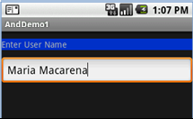
Basic Widgets: EditText
Example
...
<EditText
android:id="@+id/txtUserName"
android:layout_width="fill_parent"
android:layout_height="wrap_content"
android:textSize="18sp"
android:autoText="true"
android:capitalize="words"
android:hint="First Last Name"
>
</EditText>

Slide 14
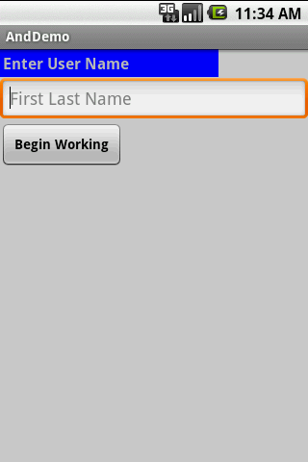
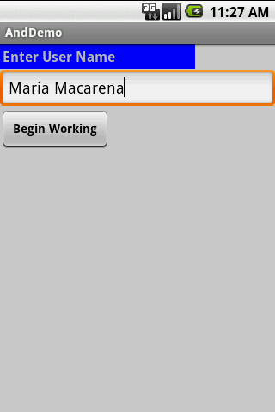
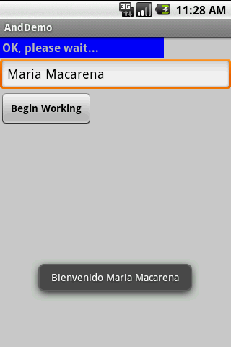
Basic Widgets: Example 1
In this little example we will use an LinearLayout holding a label( TexView), a textBox(EditText), and a Button.
We will use the view as a sort of simplified login screen.

Slide 15
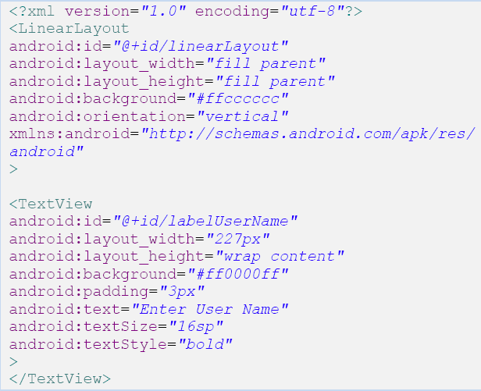
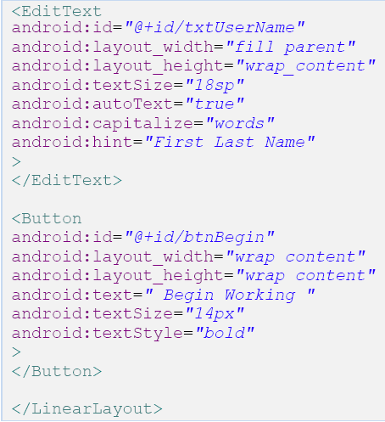
Basic Widgets: Example 1

Slide 16
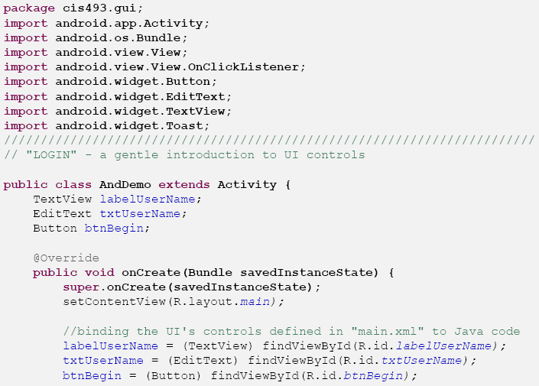
Basic Widgets: Example 1
Android’s Application (1 of 2)

Slide 17
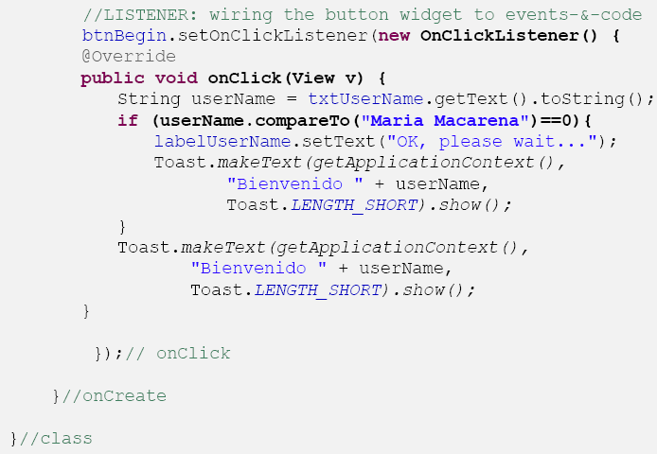
Basic Widgets: Example 1
Android’s Application (2 of 2)

Slide 18
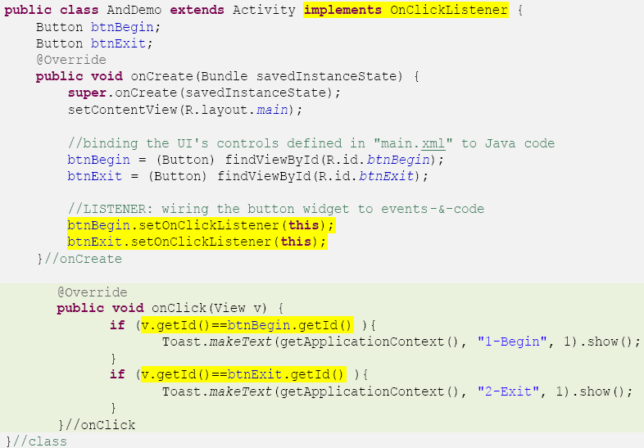
Basic Widgets: Example 1
Another way of defining a Listener for multiple button widgets

Slide 19
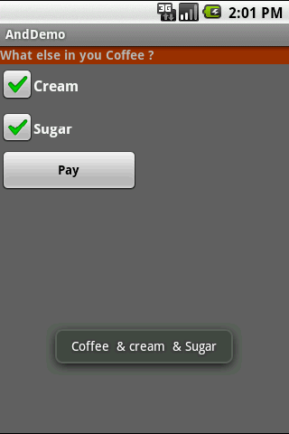
Basic Widgets: CheckBox
A checkbox is a specific type of two-states button that can be either checked or unchecked.
An example usage of a checkbox inside your activity would be the following:

Slide 20
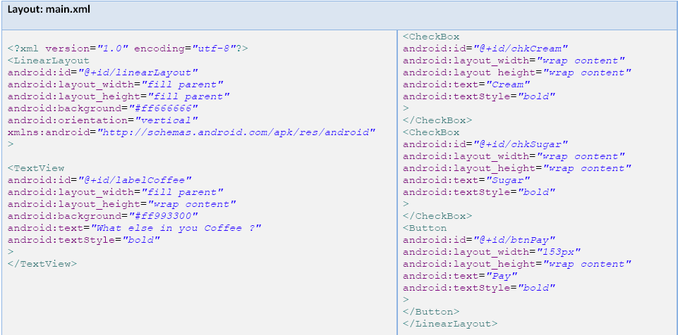
Basic Widgets: CheckBox
Complete code for the checkBoxdemo (1 of 3)

Slide 21
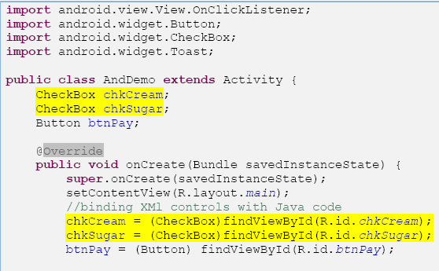
Basic Widgets: CheckBox
Complete code for the checkBoxdemo (2 of 3)

Slide 22
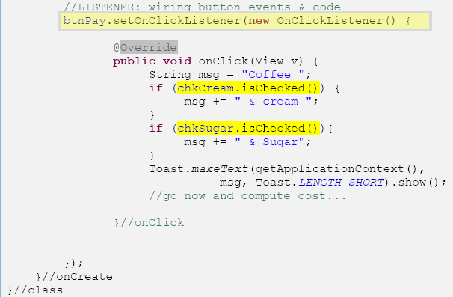
Basic Widgets: CheckBox
Complete code for the checkBox demo (3 of 3)

Slide 23
Basic Widgets: RadioButtons
A radio button is a two-states button that can be either checked or unchecked.
When the radio button is unchecked, the user can press or click it to check it.
Radio buttons are normally used together in a RadioGroup.
When several radio buttons live inside a radio group, checking one radio button unchecks all the others.
Similarly, you can call isChecked() on a RadioButtonto see if it is selected, toggle() to select it, and so on, like you can with a CheckBox.

Slide 24
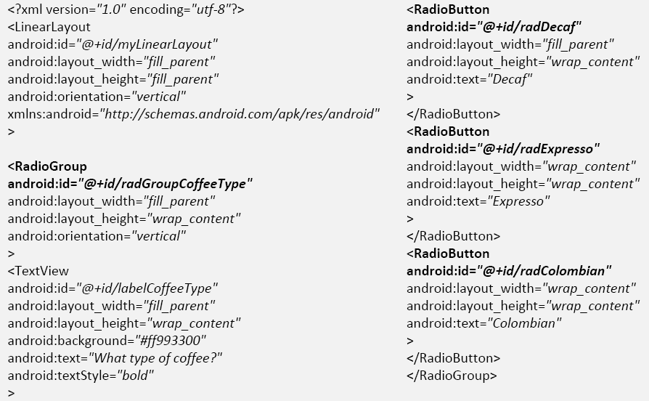
Basic Widgets: RadioButtons
We extend the previous example by adding a RadioGroupand three RadioButtons. Only new XML and Java code is shown:

Slide 25
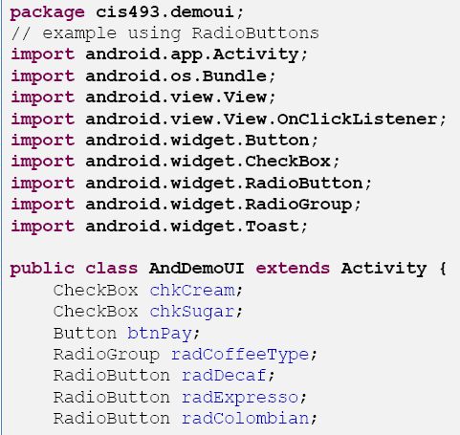
Basic Widgets: RadioButtons
Android Activity (1 of 3)

Slide 26
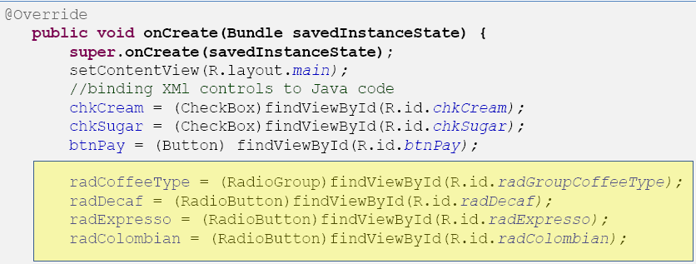
Basic Widgets: RadioButtons
Android Activity (2 of 3)

Slide 27
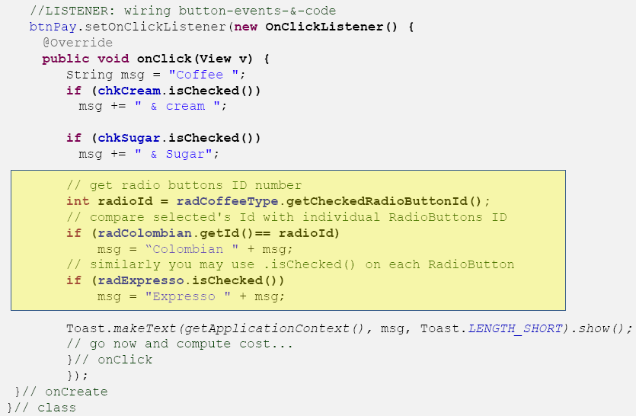
Basic Widgets: RadioButtons

Slide 28
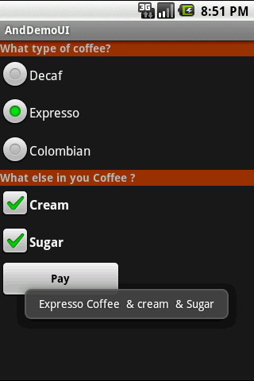
Basic Widgets: RadioButtons
Example
This UI uses RadioButtons
and CheckBoxes
to define choices
RadioGroup
Summary of choices

Slide 29
Unit measurement in Android
px = Pixels – corresponds to actual pixels on the screen.
pt = Points – 1/72 of an inch based on the physical size of the screen.
dp
Density-independent Pixels – an abstract unit that is based on the physical density of the screen. These units are relative to a 160 dpi screen, so one dp is one pixel on a 160 dpi screen. The ratio of dp-to-pixel will change with the screen density, but not necessarily in direct proportion. Note: The compiler accepts both “dip” and “dp”, though “dp” is more consistent with “sp”.
sp
Scale-independent Pixels – this is like the dp unit, but it is also scaled by the user’s font size preference. It is recommend you use this unit when specifying font sizes, so they will be adjusted for both the screen density and user’s preference.

