Slide 1
Android Using Menus
Yuliana Setiowati
Rizky Yuniar Hakkun
Ahmad Syauqi Ahsan

Slide 2
Outline
ContextMenu
OptionMenu

Slide 3
Using Menus
Menus is not consuming ‘much’ view space.
Android provides two types of menu known as: options menu and context menu.
The options menu is triggered by pressing the hardware Menu button on the device, while
The context menu is raised by a tap-and-hold on the widget associated to the menu.

Slide 4
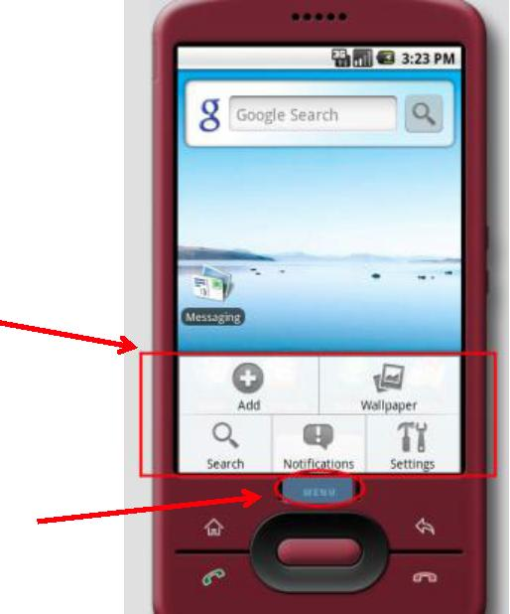
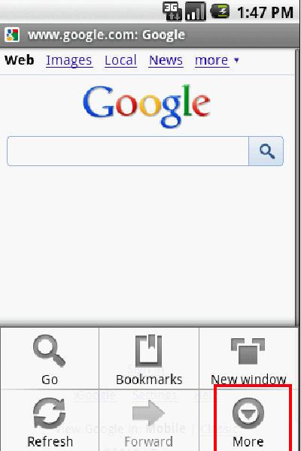
Using Menus
Example: Using an option menu
Options available in this context
Press Menu Button
A max of six entries per menu. Excess will be displayed as part of the More option

Slide 5
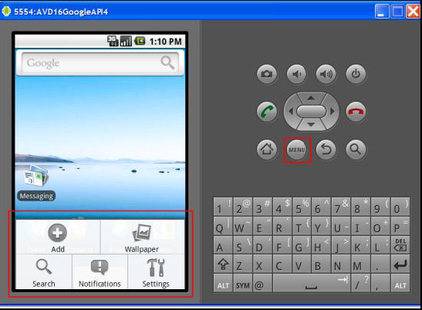
Using Menus
Example: Using an option menu
Press Menu
button
Available
Options in
this context

Slide 6
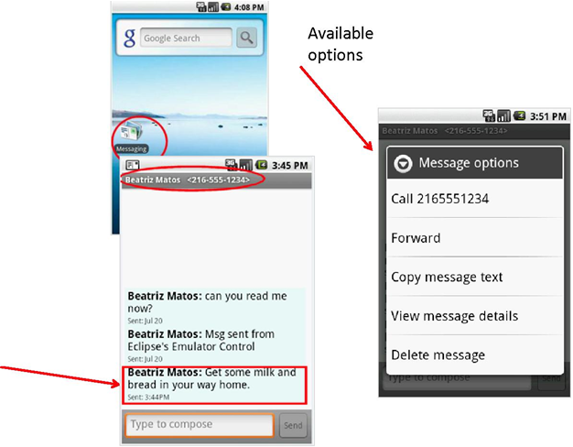
Using Menus
Example :
Dealing with SMS (text-messages) by using the built-in Messaging app’s
context menu
Tap-&-Hold

Slide 7
Using Menus
Comments on Creating Context Menu
Indicate which widget(s) on your activity have context menus. To do this, call
registerForContextMenu(theWidget)
supplying the View that is the widget needing a context menu.
Implement onCreateContextMenu(…)
To find out when a context menu choice was chosen, implement onContextItemSelected() on the activity.

Slide 8
Using Menus
Comments on Creating Option Menu
Pressing the hardware Menu button on the device.
Implement onCreateOptionMenu(…)
To find out when a option menu choice was chosen, implement onOptionItemSelected() on the activity.

Slide 9
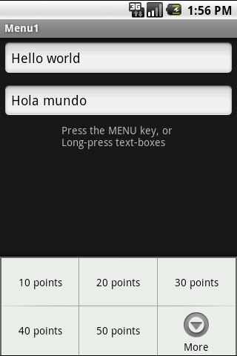
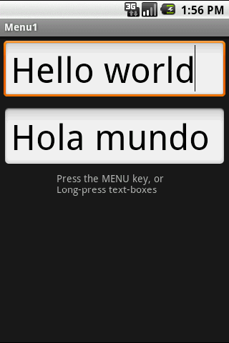
Using Menus Example 1
Example 1: Using an Option Menu
In this application the Option menu offers a way of changing the text size (on both EditText boxes)
Click on Menubutton to see size options
After choosing option:
50 points

Slide 10
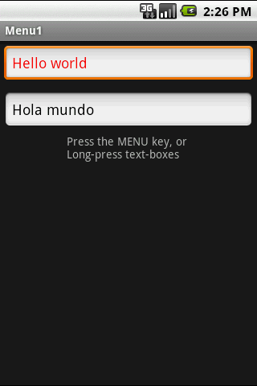
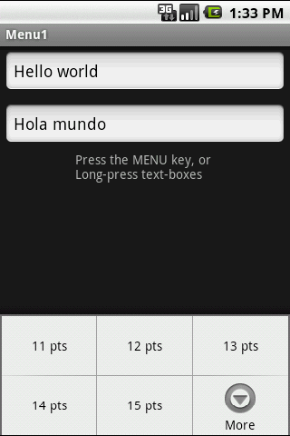
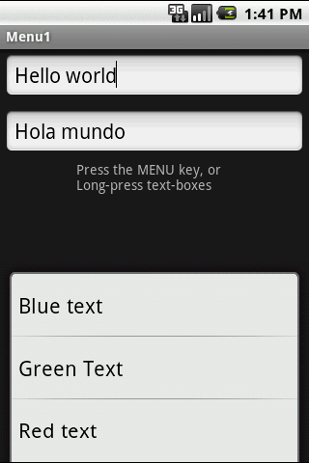
Using Menus Example 1
Example 1: Using an Option Menu
Up to six options will be displayed on the Option menu.
If there are more than six options pushing the More button will show the rest
Click the More button to see additional options
Additional choices of the Option menu

Slide 11
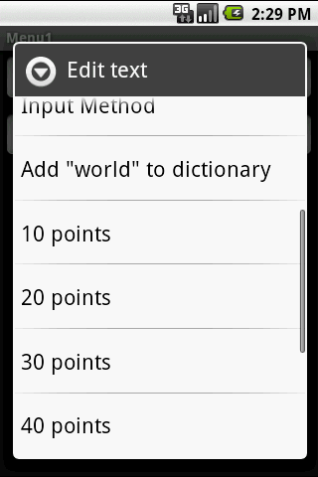
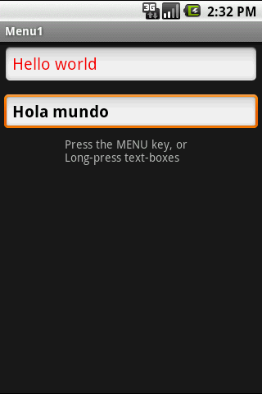
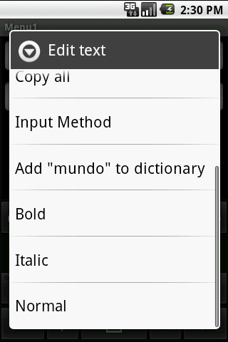
Using Menus Example 1
Example 1: Using a Context Menu
Each view could have an associated
Context Menu
Long-press a textbox to invoke its Context Menu

Slide 12
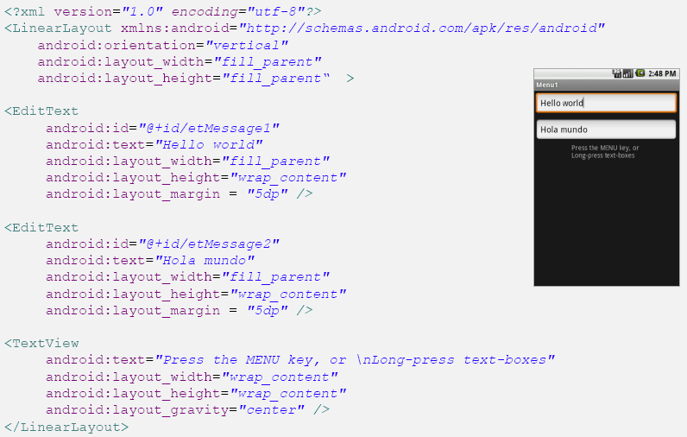
Using Menus Example 1
Example 1: Using Option and Context Menu
The app shows two text boxes. Menus are used to change text’s size, color, and style.

Slide 13
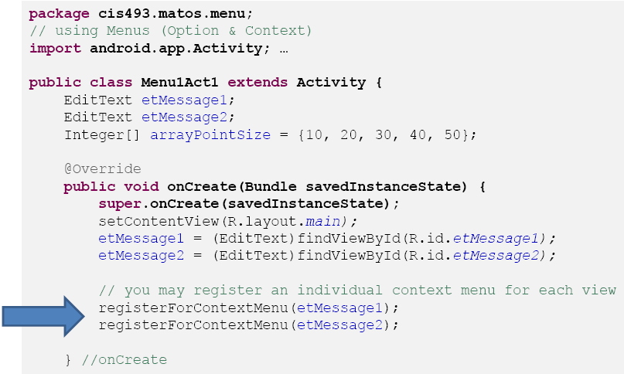
Using Menus Example 1
Example 1: Using Option and Context Menu
The app shows two text boxes. Menus are used to change text’s size, color, and style.

Slide 14
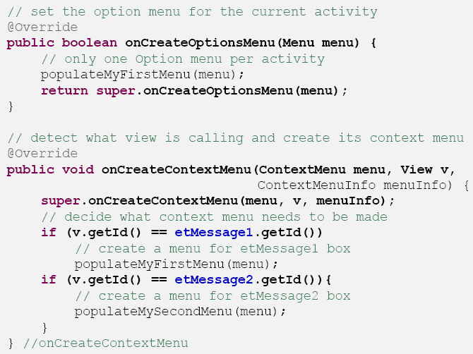
Using Menus Example 1
Example 1: Using Option and Context Menu
The app shows two text boxes. Menus are used to change text’s size, color, and style.

Slide 15
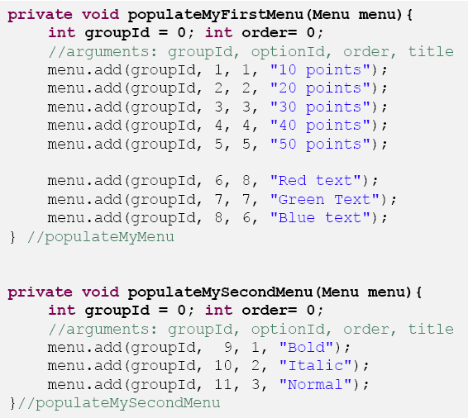
Using Menus Example 1
Example 1: Using Option and Context Menu
The app shows two text boxes. Menus are used to change text’s size, color, and style.

Slide 16
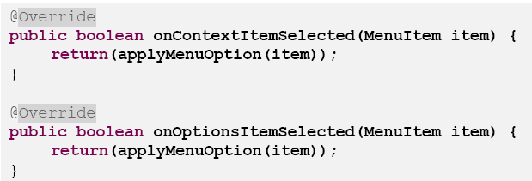
Using Menus Example 1
Example 1: Using Option and Context Menu
The app shows two text boxes. Menus are used to change text’s size, color, and style.

Slide 17
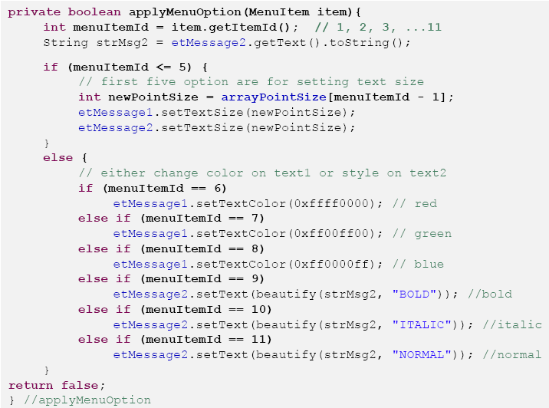
Using Menus Example 1
Example 1: Using Option and Context Menu
The app shows two text boxes. Menus are used to change text’s size, color, and style.

Slide 18
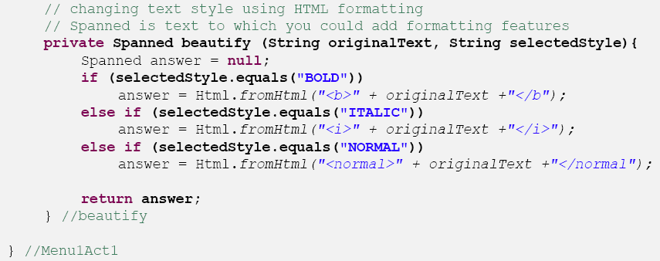
Using Menus Example 1
Example 1: Using Option and Context Menu
The app shows two text boxes. Menus are used to change text’s size, color, and style.

Slide 19
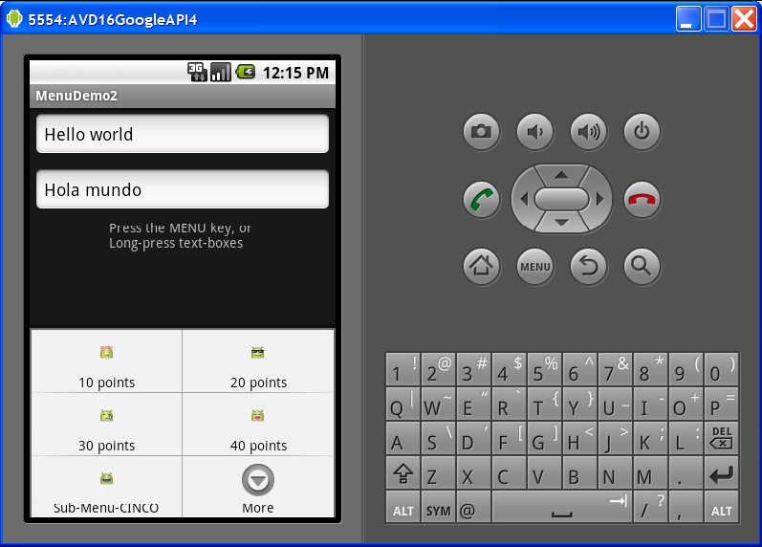
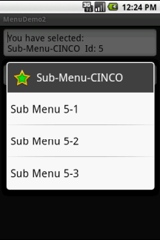
Using Menu Example 2
Example 2: Enhancing Option/Context Menu
This extension of the previous example adds icons and links to the Option Menu entries, as well as a sub-menu list tied to one the option menu buttons.
Click on SubMenu to see additional options

Slide 20
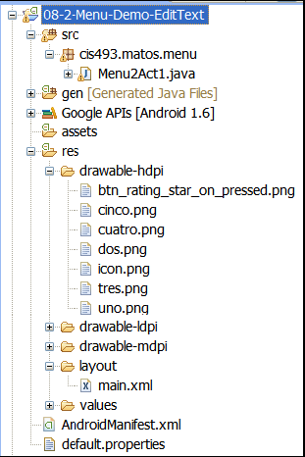
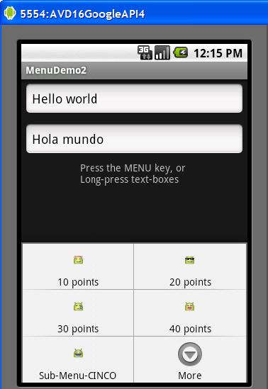
Using Menu Example 2
Example 2: Enhancing Option/Context Menu
This extension of the previous example adds icons and linksto the Option Menu entries, as well as a sub-menu list tied to one the option menu buttons.

Slide 21
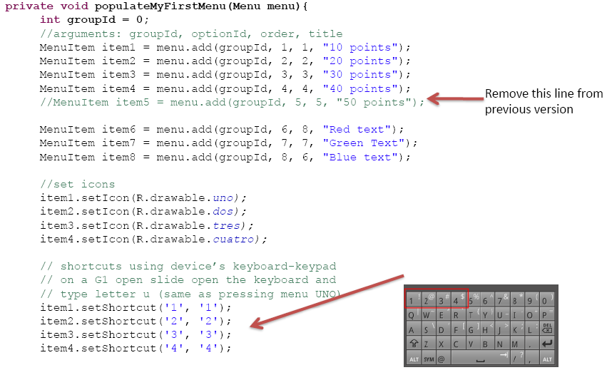
Using Menu Example 2
Replace the method
populateMyFirstMenu
with the following code
Example 2: Enhancing Option/Context Menu

Slide 22
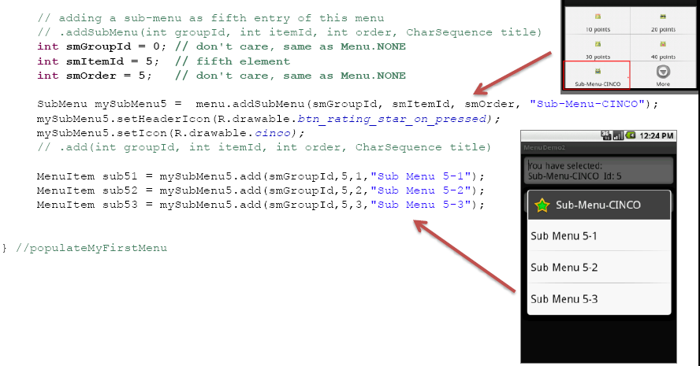
Using Menu Example 2
Continuation…
Replace the method
populateMyFirstMenu
with the following code
Example 2: Enhancing Option/Context Menu

Slide 23
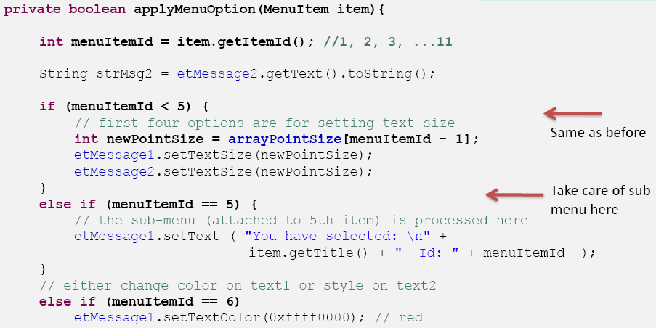
Using Menu Example 2
Continuation…
Replace the method
applyMenuOption
with the following code
Example 2: Enhancing Option/Context Menu

Slide 24
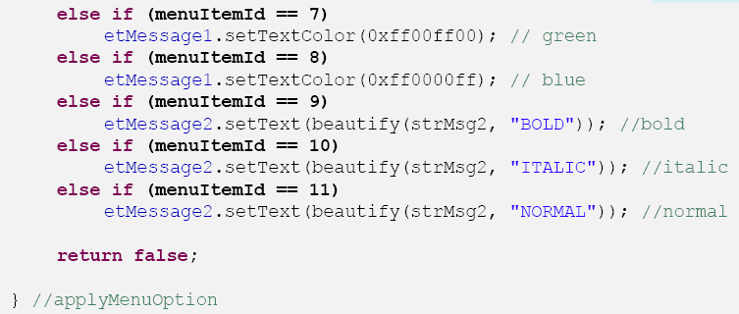
Using Menu Example 2
Continuation…
Replace the method
applyMenuOption
with the following code
Same as before
Example 2: Enhancing Option/Context Menu

Slide 25
Using Menu
Comments on Creating Submenus
Submenus are displayed as regular Menus Items. When selected they just display more options.
To avoid cluttered UIs, submenus are not displayed using three-like structure, instead they appear as a simple floating window presenting a list of items.
Android does not support nested submenus.

Slide 26
Using Menu
Comments on Creating Submenus
Example:
Extend previous example by adding a fifth entry to the existing menu list. The new entry is of the SubMenutype. It should offer three options of its own.
Note: add this code to the end of the: onCreateOptionsMenu(…)method.

Slide 27
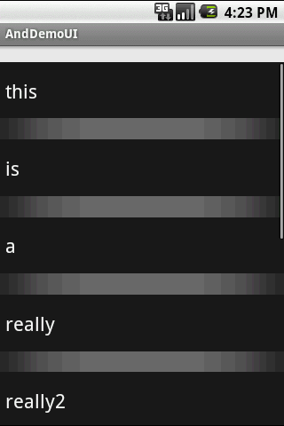
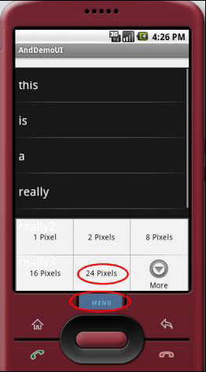
Using Menu Example 3
Example 3: Using Option/Context Menu
Observe how the selection made from the Menu changes the inter-row spacing of the ListView.
Click on Menu to see spacing options
After choosing option:
24 Pixels
of row separation

Slide 28
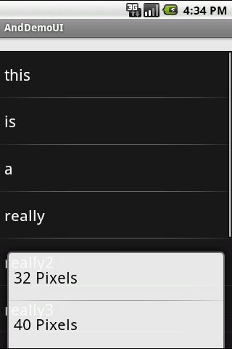
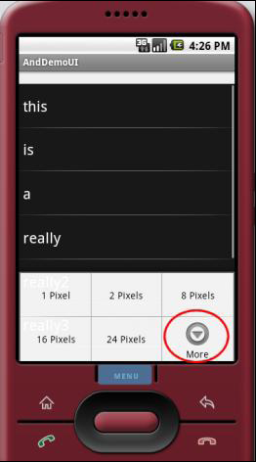
Using Menu Example 3
Example 3: Using Option
Click on Menu to see spacing options
After choosing option:
More
a new menu is shown

Slide 29
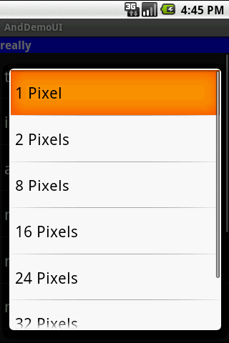
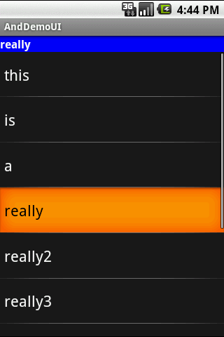
Using Menu Example 3
Example 3: Using a Context Menu
Tap & Hold
any row to bring
Context Menu
Choices listed in a floating
ListView

Slide 30
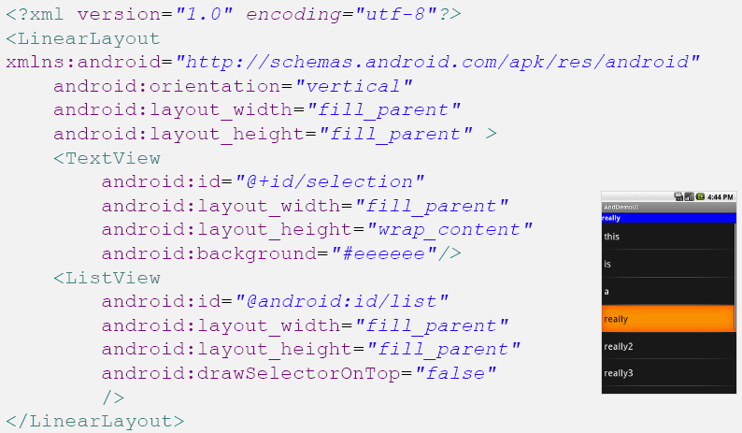
Using Menu Example 3
Example 3: Creating an Option & Context Menu

Slide 31
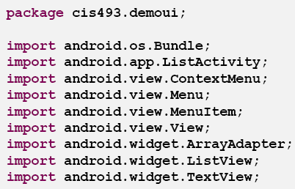
Using Menu Example 3
Example 3: Creating an Option & Context Menu

Slide 32
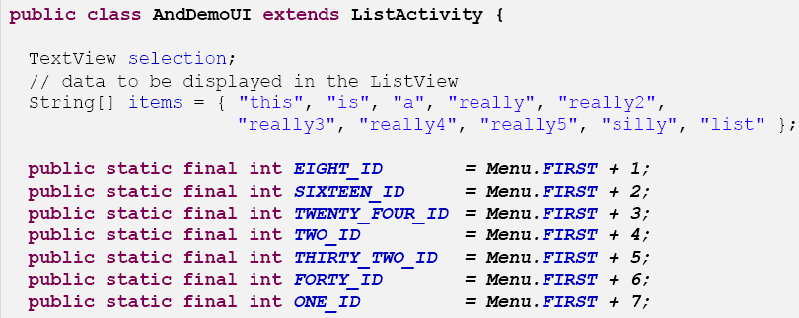
Using Menu Example 3
Example 3: Creating an Option & Context Menu

Slide 33
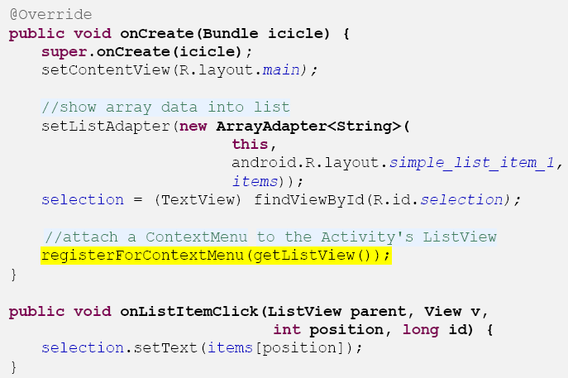
Using Menu Example 3
Example 3: Creating an Option & Context Menu

Slide 34
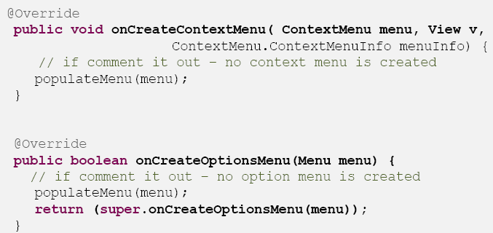
Using Menu Example 3
Example 3: Creating an Option & Context Menu

Slide 35
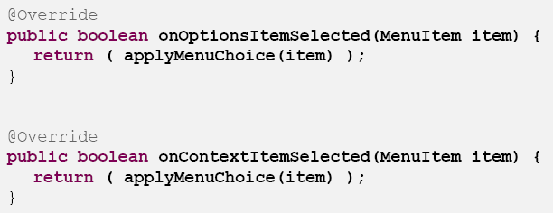
Using Menu Example 3
Example 3: Creating an Option & Context Menu

Slide 36
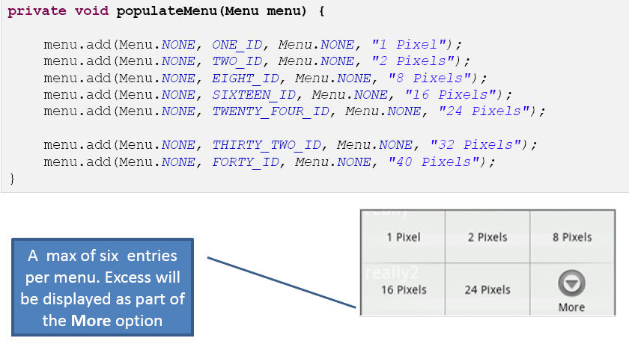
Using Menu Example 3
Example 3: Creating an Option & Context Menu

Slide 37
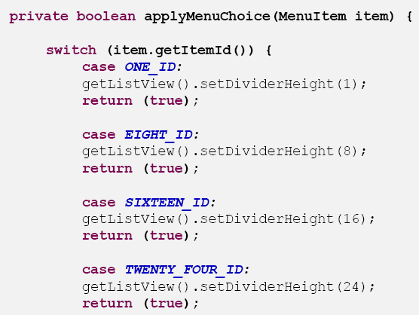
Using Menu Example 3
Example 3: Creating an Option & Context Menu

Slide 38
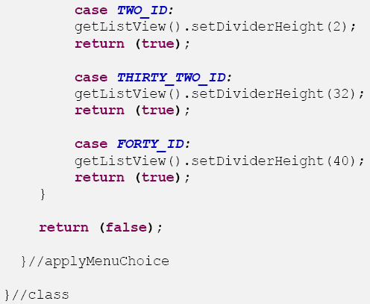
Using Menu Example 3
Example 3: Creating an Option & Context Menu

Slide 39
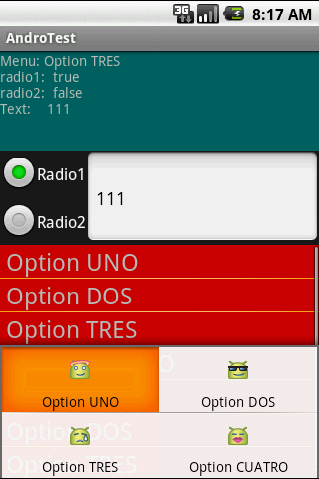
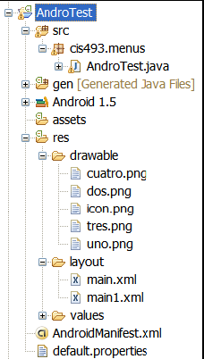
Using Menu Example 4
Example 4: Another App Using Menus that include Icons & Text
This is a simple application designed around a TableLayout.
1. The first row shows a summary of the data collected from the screen.
2. The second row exposes a RadioGroupand a textBox.
3. The third row shows a list of the calls made to the option and context menus.
This Option Menu shows its options using text & icons

Slide 40
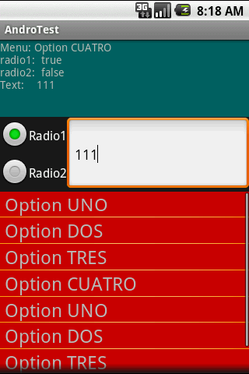
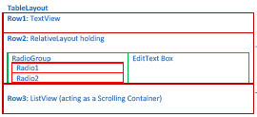
Using Menu Example 4
Example 4: Another App Using Menus that include Icons & Text
Application’s Layout

Slide 41
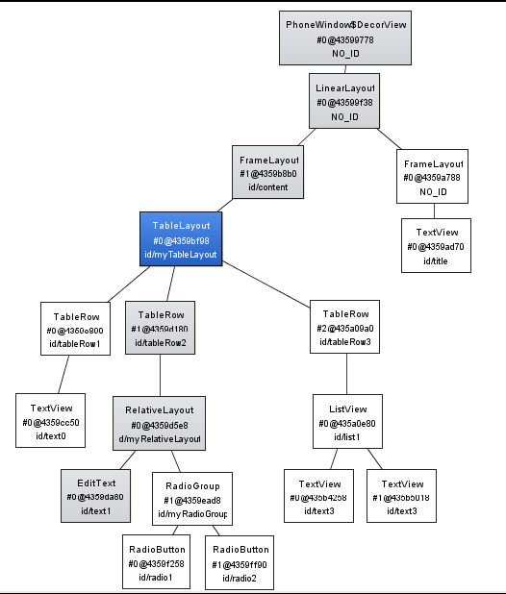
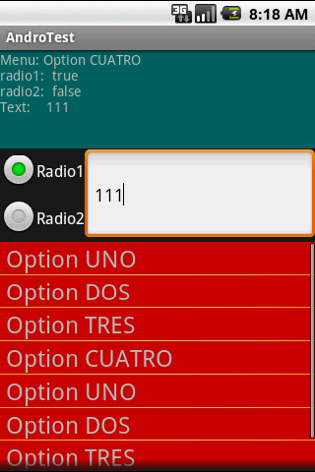
Using Menu Example 4
Example 4: Another App Using Menus that include Icons & Text
Application’s Layout.
Hierarchy View

Slide 42
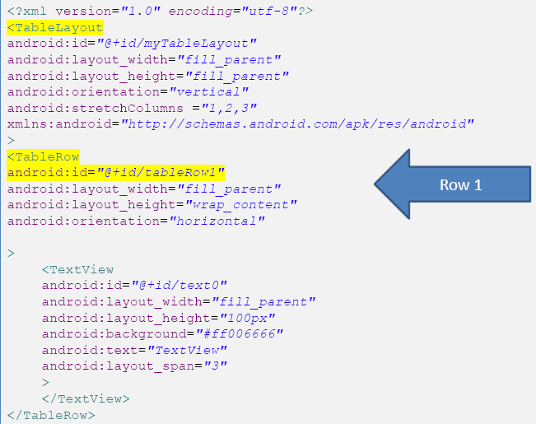
Using Menu Example 4

Slide 43
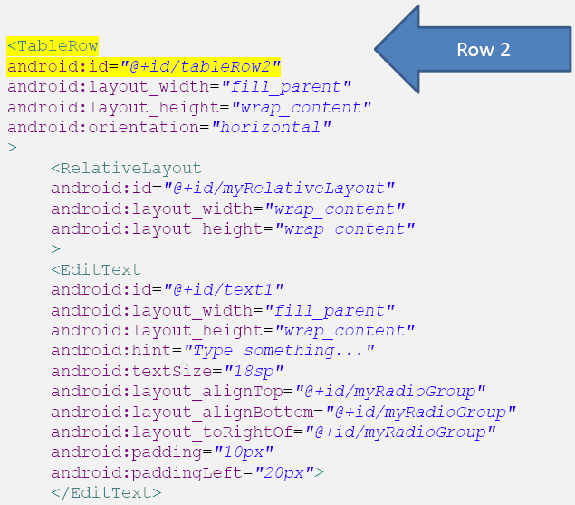
Using Menu Example 4

Slide 44
Using Menu Example 4

Slide 45
Using Menu Example 4

Slide 46
Using Menu Example 4
Example 4. Menu Using Icons & Text
This custom layout (main1.xml) is used to show the ListView rows (shown as red rows –big font )

Slide 47
Using Menu Example 4
Example 4. Menu Using Icons & Text

Slide 48
Using Menu Example 4
Example 4. Menu Using Icons & Text

Slide 49
Using Menu Example 4
Example 4. Menu Using Icons & Text

Slide 50
Using Menu Example 4
Example 4. Menu Using Icons & Text

Slide 51
Using Menu Example 4
Example 4. Menu Using Icons & Text

Slide 52
Using Menu Example 4
Example 4. Menu Using Icons & Text

Slide 53
Using Menu
Comments on Creating Submenus
Example:
Extend previous example by adding a fifth entry to the existing menu list. The new entry is of the SubMenutype. It should offer three options of its own.

