Slide 1
INTENT
Android Development
Yuliana Setiowati
Rizky Yuniar Hakkun
Ahmad Syauqi Ahsan

Slide 2
Objectives
What you will learn…
Understanding activities.
Understanding the concept of intents
How to use the Intent object to link activities

Slide 3
Activity
An activity is a window that contains the user interface of your applications
An application can have zero or more activities
Typically, applications have one or more activities, and the main aim of an activity is to interact with the user

Slide 4
Intents
Intents are used as a message-passing mechanism that works both within your application, and between applications
An Android application could include any number of activities.
Activities are independent of each other;
Main activity is designated as the first one (main) that should be presented to the user when the application is launched.
Moving from one activity to another is accomplished by asking the current activity to execute an intent.

Slide 5
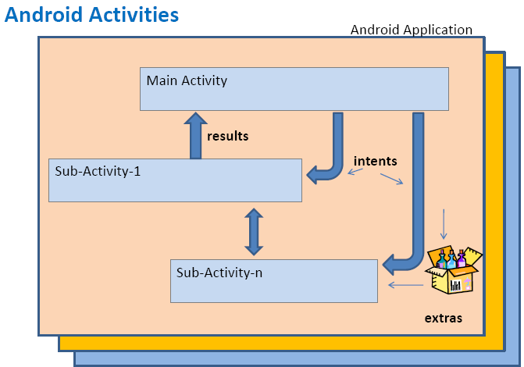
Intents

Slide 6
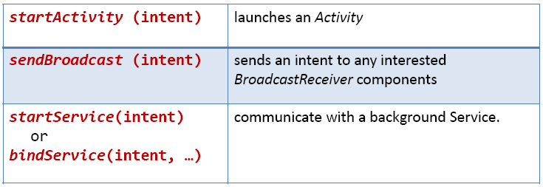
Intents
Intents are invoked using the following options

Slide 7
Intents
The main arguments of an Intent are:
Action
The built-in action to be performed, such as ACTION_VIEW, ACTION_EDIT, ACTION_MAIN, or user-created-activity
Data
The primary data to operate on, such as a phone number to be called (expressed as a URI).

Slide 8
Intents
Typically an intent is called as follows:
Intent myActivity= new Intent(action, data);
startActivity(myActivity);
Built-in or user-created activity
Primary data
(as an URI)
tel://
http://
sendto://

Slide 9
Intents
Intents List: Invoking Google Applications on Android Devices
http://developer.android.com/guide/appendix/g-app-intents.html

Slide 10
Intents
Examples of action/data pairs are:
ACTION_DIAL tel:123
Display the phone dialer with the given number filled in.
ACTION_VIEW http://www.google.com
Show Google page in a browser view. Note how the VIEW action does what is considered the most reasonable thing for a particular URI.
ACTION_EDIT content://contacts/people/2
Edit information about the person whose identifier is "2".
ACTION_VIEW content://contacts/people/2
Used to start an activity to display 2-ndperson.
ACTION_VIEW content://contacts/people/Display
a list of people, which the user can browse through. Selecting a particular person to view would result in a new intent

Slide 11
Built-in Standard Actions
List of standard actions that Intents can use for launching activities(usually through startActivity(Intent)).
ACTION_MAIN
ACTION_VIEW
ACTION_ATTACH_DATA
ACTION_EDIT
ACTION_PICK
ACTION_CHOOSER
ACTION_GET_CONTENT
ACTION_DIAL
ACTION_CALL
ACTION_SEND
ACTION_SENDTO
ACTION_ANSWER
ACTION_INSERT
ACTION_DELETE
ACTION_RUN
ACTION_SYNC
ACTION_PICK_ACTIVITY
ACTION_SEARCH
ACTION_WEB_SEARCH
ACTION_FACTORY_TEST

Slide 12
Projects : Intent Example
This example show how intent can be used for calling another built in application, like phone dial, contact, browser, ets

Slide 13
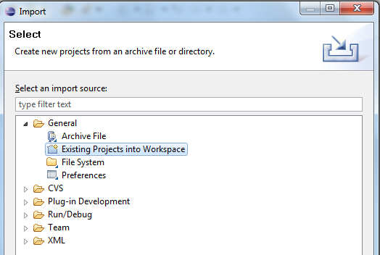
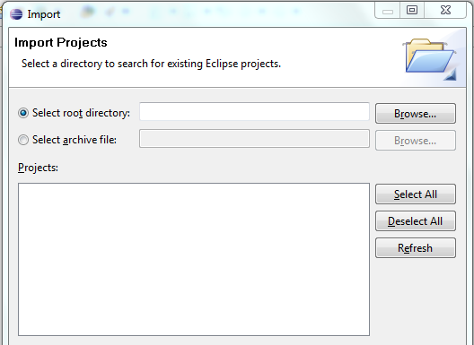
Import Project
Open Eclipse
Select: File > Import
Chose project (project name : IntentExample)
Click: Finish

Slide 14
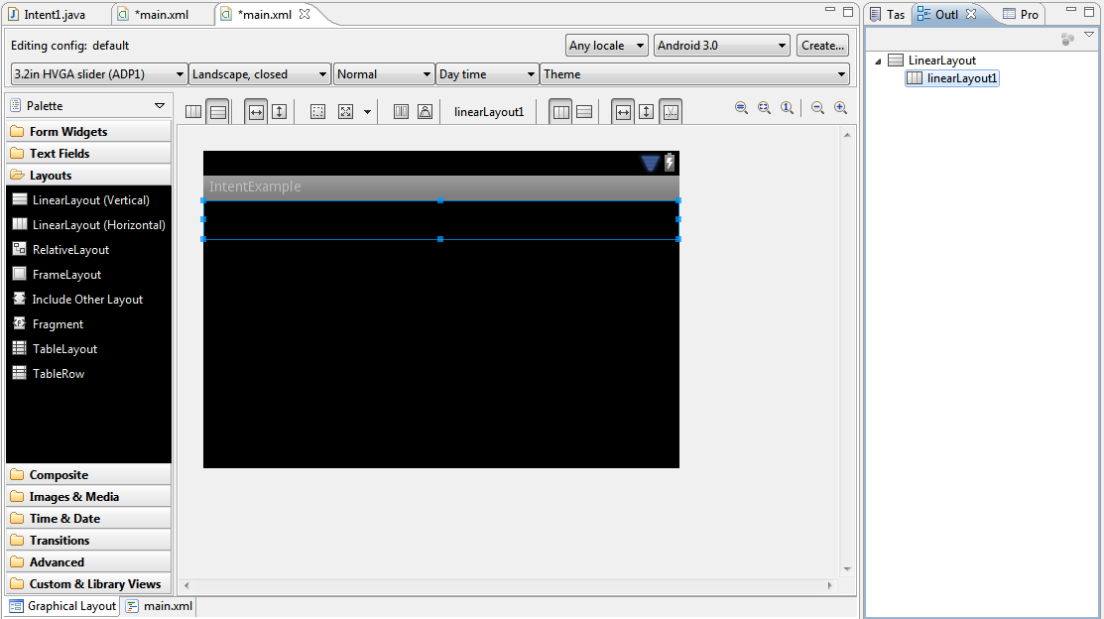
Layout (main.xml)
Drag “LinearLayout” and drop here…!!!

Slide 15
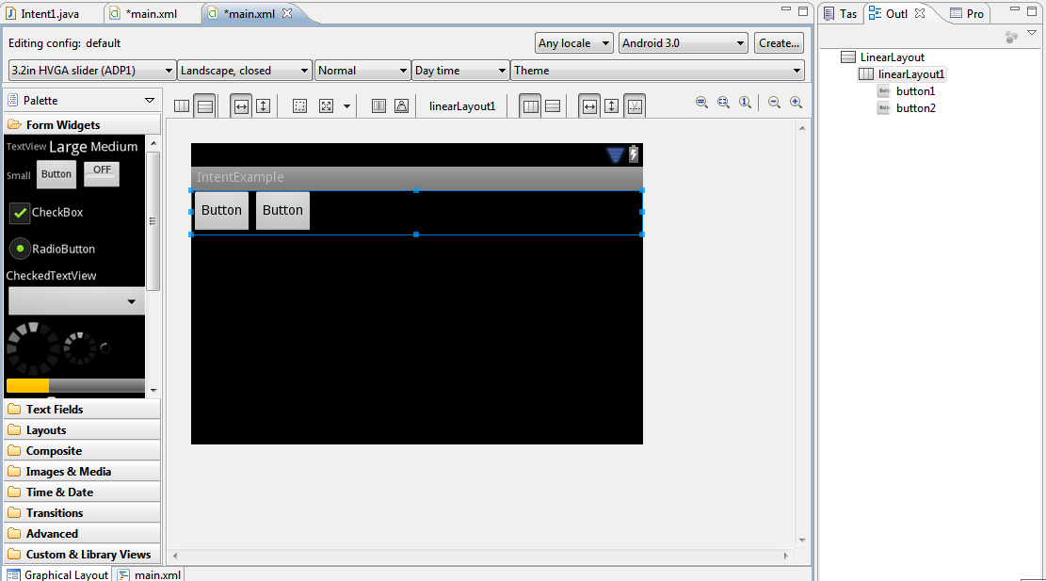
Add Button
Drag 2 “Button” and drop to “Linearlayout” …!!!

Slide 16
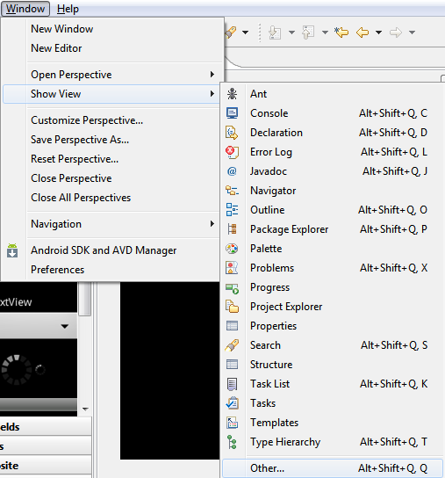
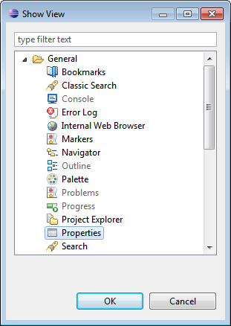
Showing Properties
Set properties for each button.
Click Menu Window -> Show View -> Other..
Dialog appear, choose General -> Properties

Slide 17
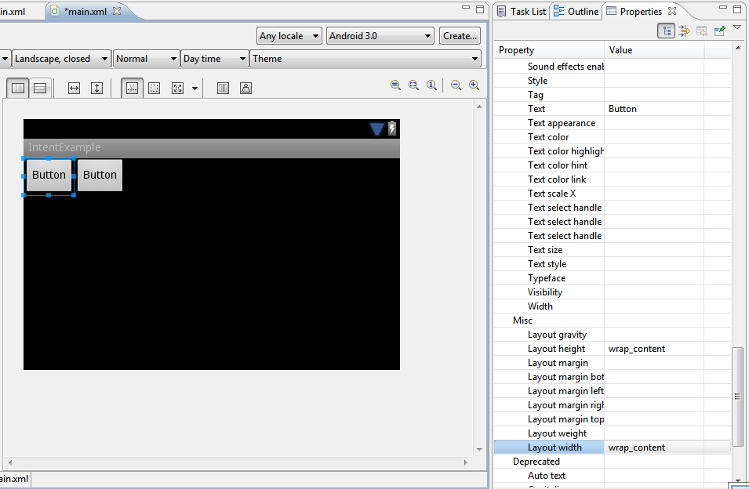
Rename and Rearrange Button
Choose a button and see the properties, search ‘Text’ and ‘Layout’ properties.
For 1st button :
Set ‘Text’ prop. = Call
Set ‘Layout Weight’ prop. = 1
Set ‘Layout width’ = fill_parent
For 2nd button :
Set ‘Text’ prop. = Web Search
Set ‘Layout Weight’ prop. = 1
Set ‘Layout width’ = fill_parent

Slide 18
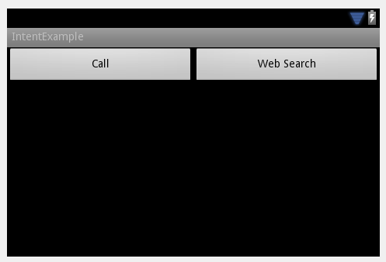
User Interface Result

Slide 19
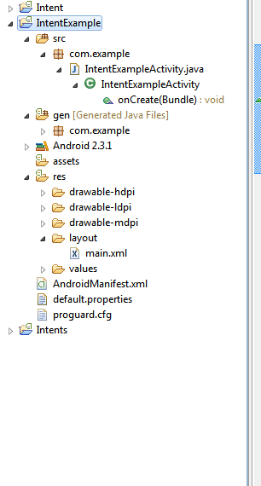
# Variable Declaration
Open IntentExampleActivity.java.
Type this codes into your program.

Slide 20
# Component Declaration
This program is the declaration for component that has been made in main.xml to be recognize in IntentExampleActivity.java.

Slide 21
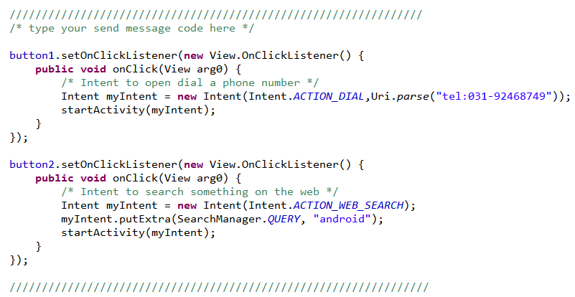
#Intent Codes
Example for call the built in android dial application
Example for searching ‘android’ on the web

Slide 22
#Other intent example
Try it : Replace existing codes in ‘#Intent Codes’ slide or create new button to apply following intents example :
Intent for calling send message application :
Intent for calling contact application :
Intent for calling browser application and open a web

Slide 23
!! Good Luck !!

