Slide 1
Heuristic Searching
Kecerdasan Komputational

Slide 2
Algoritma Pencarian (Searching)
Merupakan algoritma untuk mencari kemungkinan penyelesaian
Sering dijumpai oleh peneliti di bidang AI
Dalam melakukan pencarian, salah satu cara yang banyak digunakan untuk menggambarkan masalah adalah dengan mencantumkan atau menggambarkan semua kemungkinan keadaan yang ada.
Memecahkan masalah berarti bergerak atau berpindah dari satu ruang (node) dari titik awal sampai titik yang dituju (ditentukan), oleh Karena itu kita memerlukan satu set operator untuk bergerak dari satu node ke node lainnya.

Slide 3
Mendefinisikan permasalahan
Mendefinisikan suatu state space (ruang keadaan)
Menetapkan satu atau lebih state awal
Menetapkan satu atau lebih state tujuan
Menetapkan rules (kumpulan aturan)
  Generalisasi
  Asumsi

Slide 4
Atribut Pencarian
Optimalisasi: apakah algoritma dapat menemukan cost path terendah untuk mencapai goal?
Kelengkapan: apakah algoritma akan menemukan jalur menuju goal/tujuan jika memang ada?
  digunakan untuk mendefinisikan “return failure otherwise”
  jika tidak ada solusi, dan algoritma tidak dapat mendeteksinya (mendeteksi state berulang-ulang(loop)), maka akan menjadi infinite search dan tidak akan ada hasil yang dikembalikan.
Kompleksitas Waktu: waktu yang dibutuhkan untuk melakukan pencarian (contoh: jumlah nodes yang digeneralisasikan selama proses pencarian).
Kompleksitas waktu: memori yang dibutuhkan.

Slide 5
Kriteria mengukur perfomansi metode pencarian
Completeness : apakah metode tersebut menjamin penemuan solusi jika solusinya memang ada?
Time complexity : berapa lama waktu yang diperlukan? [semakin cepat, semakin baik]
Space complexity : berapa banyak memori yang diperlukan
Optimality : apakah metode tersebut menjamin menemukan solusi yang terbaik jika terdapat beberapa solusi berbeda?

Slide 6
Metode searching
Terdapat dua metode untuk melakukan pencarian yaitu dengan
  BLIND SEARCH
  HEURISTIC SEARCH

Slide 7
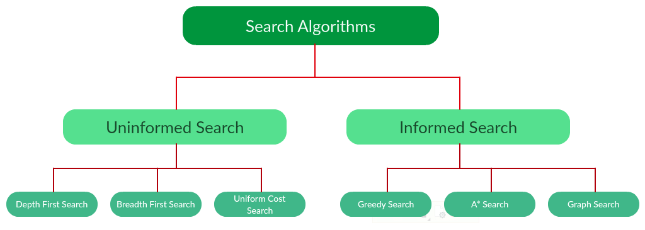
Types of search algorithms

Slide 8
HEURISTIC SEARCHING
(Informed searching)

Slide 9
Metode pencarian heuristics
Pencarian heuristik adalah teknik pencarian yang menggunakan metode heuristik untuk pergerakannya (berpindah).
Heuristik sendiri merupakan aturan praktis yang mungkin mengarah pada solusi.
Heuristik membantu mengurangi jumlah alternatif dari bilangan eksponensial menjadi bilangan polinomial.
Here, the algorithms have information on the goal state, which helps in more efficient searching.
Dalam pencarian heuristik setiap state diberi sebuah “heuristic value“ (h-value) yang digunakan pencarian dalam memilih langkah terbaik selanjutnya.
Contoh
  Generate and Test
  Hill Climbing
  Best First Search (A* dan Greedy)
  Branch and bound
  Dynamic programming
  Alpha Beta Pruning, dll

Slide 10
What is in a “heuristic?”
f(n) = g(n) + h(n)
The heuristic value of node n
The estimated cost of achieving the goal
(from current node n to the goal)
The actual cost of node n
(from the root to current node n)
Heuristics Search :
  In an informed search, a heuristic is a function that estimates how close a state is to the goal state.
  For examples – Manhattan distance, Euclidean distance, etc.
  Lesser the distance, closer the goal.
  Different heuristics are used in different informed algorithms.

Slide 11
Heuristic / Informed Search Algorithms
This information is obtained by something called a heuristic.
Example of Informed Search Algorithms:
  Generate and Test
  Best First Search
    2.1. Greedy Search
    2.2. A* Tree Search
  A* Graph Search
  Hill Climbing
  Branch and bound
  Dynamic programming
  Alpha Beta Prunning

Slide 12
Heuristic Searching 1.
Generate and Test Algorithm
Merupakan algoritma searching yang paling sederhana yang menjamin untuk menemukan solusi jika dilakukan secara sistematis dan ada solusinya
Pada prinsipnya metode ini merupakan penggabungan antara depth-first search dengan pelacakan mundur (backtracking), yaitu bergerak ke belakang menuju pada suatu keadaan awal.
Efisien untuk masalah sederhana.

Slide 13
Kelemahan Generate and Test algorithm
Kurang efisien untuk masalah yang besar atau kompleks.
Perlu membangkitkan semua kemungkinan sebelum dilakukan pengujian
Membutuhkan waktu yang cukup lama dalam pencariannya karena harus menentukan semua kemungkinan terlebih dahulu sebelum melakukan pengujian.

Slide 14
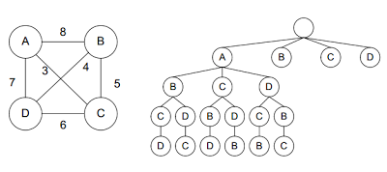
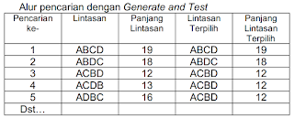
Contoh Generate & Test : “Travelling Salesman Problem (TSP)”
Seorang salesman ingin mengunjungi n kota.
Jarak antara tiap-tiap kota sudah diketahui.
Kita ingin mengetahui rute terpendek dimana setiap kota hanya boleh dikunjungi tepat 1 kali.
Misalkan ada 4 kota (A, B, C, dan D) dengan jarak antara tiap-tiap kota seperti tampak pada graph.
Algoritma
Generate & Test

Slide 15
Algoritma Generate and Test
Tentukan suatu kemungkinan solusi (menentukan suatu titik tertentu atau lintasan tertentu dari keadaan awal).
Uji untuk melihat apakah node tersebut benar-benar merupakan solusinya dengan cara membandingkan node tersebut atau node akhir dari suatu lintasan yang dipilih dengan kumpulan tujuan yang diharapkan.
Jika solusi ditemukan, keluar. Jika tidak, ulangi kembali langkah yang pertama.

Slide 16
Heuristic Searching 2.
Best First Search Algorithm https://www.mygreatlearning.com/blog/best-first-search-bfs/
Use an evaluation function to decide which among the various available nodes is the most promising (or ‘BEST’) before traversing to that node.
The Best first search uses the concept of a Priority queue and heuristic search.
To search the graph space, the BFS method uses two lists for tracking the traversal.
An ‘OPEN’ list which keeps track of the current ‘immediate’ nodes available for traversal and ‘CLOSED’ list that keeps track of the nodes already traversed.

Slide 17
Best First Search Algorithm
Create 2 empty lists: OPEN and CLOSED
Start from the initial node (say N) and put it in the ‘ordered’ OPEN list
Repeat the next steps until GOAL node is reached
  If OPEN list is empty, then EXIT the loop returning ‘False’
  Select the first/top node (say N) in the OPEN list and move it to the CLOSED list. Also capture the information of the parent node
  If N is a GOAL node, then move the node to the Closed list and exit the loop returning ‘True’. The solution can be found by backtracking the path
  If N is not the GOAL node, expand node N to generate the ‘immediate’ next nodes linked to node N and add all those to the OPEN list
  Reorder the nodes in the OPEN list in ascending order according to an evaluation function f(n)
This algorithm will traverse the shortest path first in the queue.
The time complexity of the algorithm is given by O(n*logn) .

Slide 18
Variants of Best First Search
2.1. Greedy Best First Search
2.2. A* Best First Search.
The only difference between Greedy BFS and A* BFS is in the evaluation function.
For Greedy BFS, the evaluation function is f(n) = h(n).
For A* BFS, the evaluation function is f(n) = g(n) + h(n).

Slide 19
2.1. Greedy Best First Search Algorithm (1) https://www.javatpoint.com/ai-informed-search-algorithms https://www.mygreatlearning.com/blog/best-first-search-bfs/
The Greedy BFS algorithm selects the path which appears to be the best at the moment.
It is the combination of depth-first search and breadth-first search algorithms.
It uses the heuristic function and search.
Best-first search allows us to take the advantages of both algorithms.
With the help of best-first search, at each step, we can choose the most promising node.

Slide 20
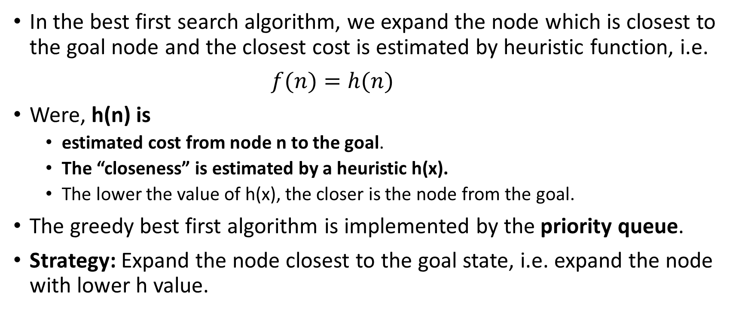
Greedy Best First Search Algorithm (2) https://www.geeksforgeeks.org/search-algorithms-in-ai/
In the best first search algorithm, we expand the node which is closest to the goal node and the closest cost is estimated by heuristic function, i.e.
$f(n)=h(n)$
Were, h(n) is
  estimated cost from node n to the goal.
  The “closeness” is estimated by a heuristic h(x).
  The lower the value of h(x), the closer is the node from the goal.
The greedy best first algorithm is implemented by the priority queue.
Strategy: Expand the node closest to the goal state, i.e. expand the node with lower h value.

Slide 21
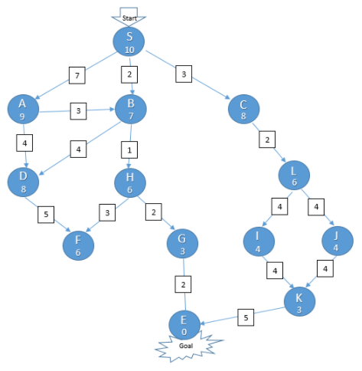
Greedy Best First Search Algorithm (3)
Example of application
Let’s say we want to drive from city S to city E in the shortest possible road distance, and we want to do it in the fastest way, by exploring the least number of cities in the way, i.e. the least number of steps.
Whenever we arrive at an intermediate city, we get to know the trip distance from that city to our goal city E. This distance is an approximation of how close we are to the goal from a given node and is denoted by the heuristic function h(n). This heuristic value is mentioned within each node. However, note that this is not always equal to the actual road distance, as the road may have many curves while moving up a hill, and more.
Also, when we travel from one node to the other, we get to know the actual road distance between the current city and the immediate next city on the way and is mentioned over the paths in the given figure. The sum of the distance from the start city to each of these immediate next city is denoted by the function g(n).
At any point, the decision on which city to go next is governed by our evaluation function. The city which gives the least value for this evaluation function will be explored first.
Heuristic value of node d

Slide 22
Greedy Best First Search algorithm:
Step 1: Place the starting node into the OPEN list.
Step 2: If the OPEN list is empty, Stop and return failure.
Step 3: Remove the node n, from the OPEN list which has the lowest value of h(n), and places it in the CLOSED list.
Step 4: Expand the node n, and generate the successors of node n.
Step 5: Check each successor of node n, and find whether any node is a goal node or not. If any successor node is goal node, then return success and terminate the search, else proceed to Step 6.
Step 6: For each successor node, algorithm checks for evaluation function f(n), and then check if the node has been in either OPEN or CLOSED list. If the node has not been in both list, then add it to the OPEN list.
Step 7: Return to Step 2.

Slide 23
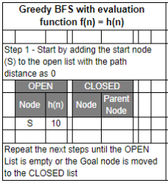
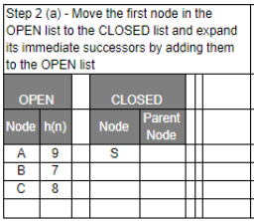
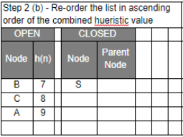
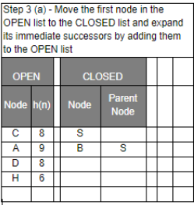
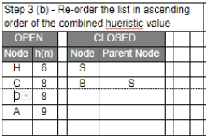
Example 1: Greedy Best-first Search Algorithm (1)
f(n) = h(n)
RE-ORDER
h(n)=10
RE-ORDER

Slide 24
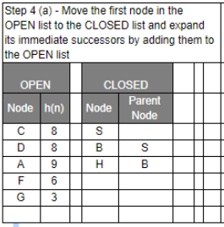
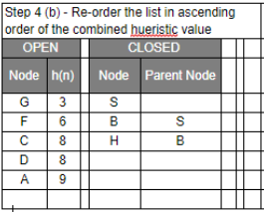
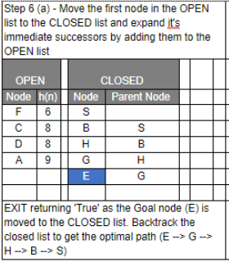
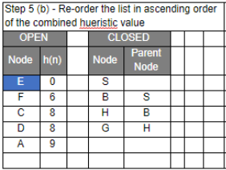
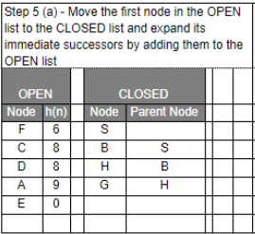
RE-ORDER
RE-ORDER
Example 1: Greedy Best-first Search Algorithm (2)
PATH: E – G – H – B - S

Slide 25
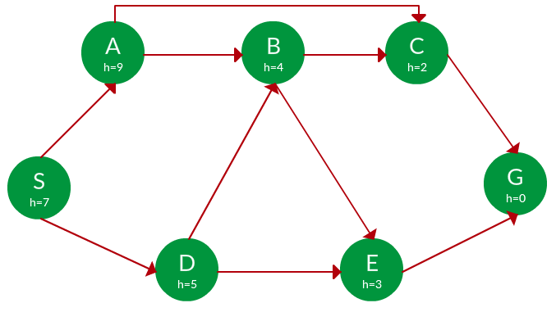
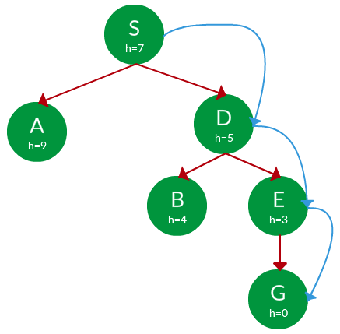
Example 2: Greedy BFS Search
Solution. Starting from S, we can traverse to A(h=9) or D(h=5). We choose D, as it has the lower heuristic cost. Now from D, we can move to B(h=4) or E(h=3). We choose E with lower heuristic cost. Finally, from E, we go to G(h=0). This entire traversal is shown in the search tree below, in blue.
Question. Find the path from S to G using greedy search. The heuristic values h of each node below the name of the node.
Selesaikan menggunakan model tabel seperti pada Example 1
Path: S -> D -> E -> G
Advantage: Works well with informed search problems, with fewer steps to reach a goal.
Disadvantage: Can turn into unguided DFS in the worst case.

Slide 26
Greedy Best-first Search Algorithm
Advantages:
  Best first search can switch between BFS and DFS by gaining the advantages of both the algorithms.
  This algorithm is more efficient than Breadth FS and Depth FS algorithms.
Disadvantages:
  It can behave as an unguided depth-first search in the worst case scenario.
  It can get stuck in a loop as DFS.
  This algorithm is not optimal.

Slide 27
Greedy Best First Search algorithm
Time Complexity: The worst case time complexity of Greedy best first search is O(b^{m}).
Space Complexity: The worst case space complexity of Greedy best first search is O(b^{m}). Where, m is the maximum depth of the search space.
Complete: Greedy best-first search is also incomplete, even if the given state space is finite.
Optimal: Greedy best first search algorithm is not optimal.

Slide 28
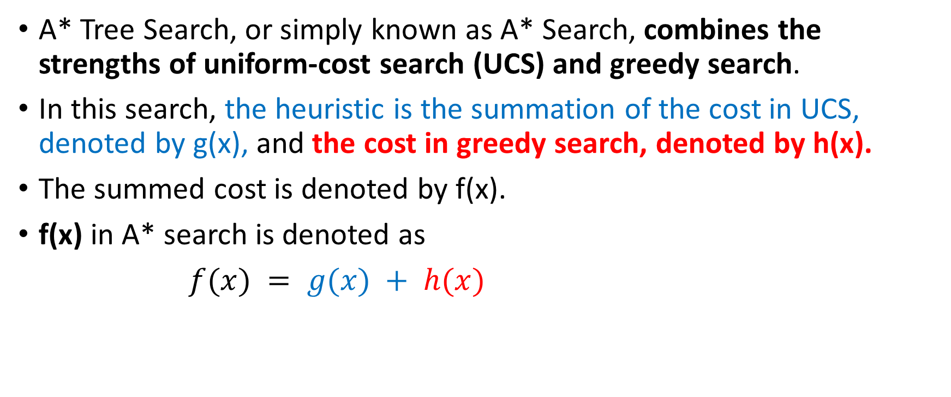
2.2. A* Tree (A* Best First) Search Algorithm https://www.geeksforgeeks.org/search-algorithms-in-ai/
A* Tree Search, or simply known as A* Search, combines the strengths of uniform-cost search (UCS) and greedy search.
In this search, the heuristic is the summation of the cost in UCS, denoted by g(x), and the cost in greedy search, denoted by h(x).
The summed cost is denoted by f(x).
f(x) in A* search is denoted as
$f(x) = g(x) + h(x)$

Slide 29
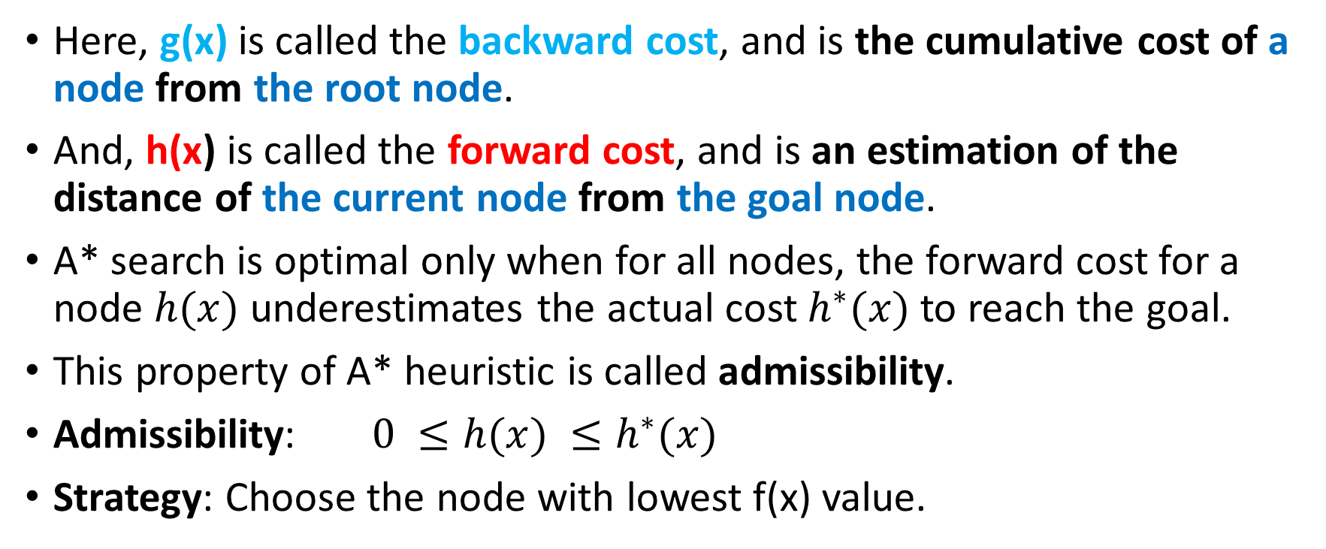
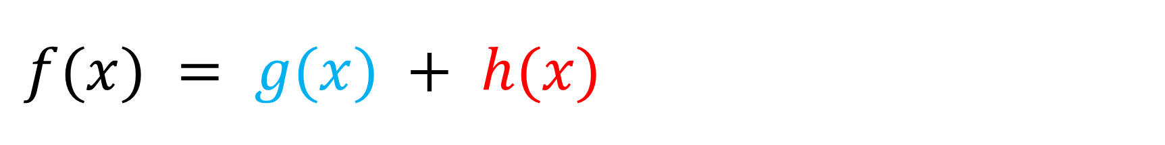
$f(x) = g(x) + h(x)$
Here, g(x) is called the backward cost, and is the cumulative cost of a node from the root node.
And, h(x) is called the forward cost, and is an estimation of the distance of the current node from the goal node.
A* search is optimal only when for all nodes, the forward cost for a node $h(x)$ underestimates the actual cost $h^{∗}(x)$to reach the goal.
This property of A* heuristic is called admissibility.
Admissibility: $0 ≤h(x) ≤h^{∗}(x)$
Strategy: Choose the node with lowest f(x) value.

Slide 30
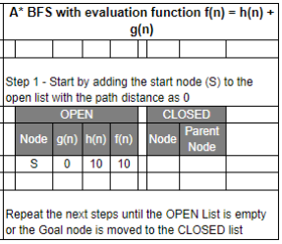
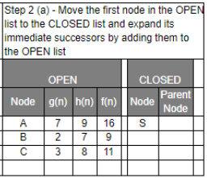
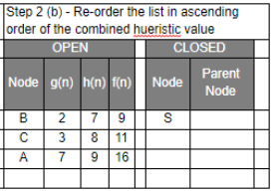
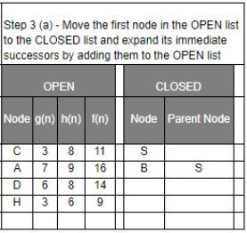
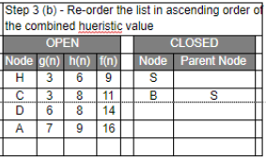
RE-ORDER by f(n)
Example 1: A* Best-first Search Algorithm (1)
f(n)=h(n)+g(n)
h(n)=10
g(n)=7
RE-ORDER by f(n)

Slide 31
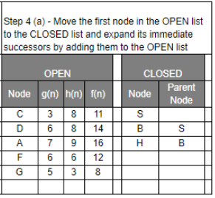
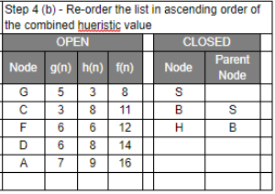
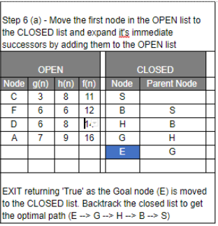
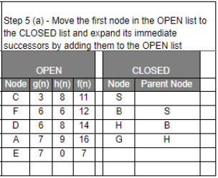
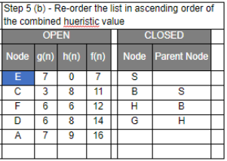
RE-ORDER by f(n)
Example 1: A* Best-first Search Algorithm (2)
RE-ORDER by f(n)
PATH: E – G – H – B - S

Slide 32
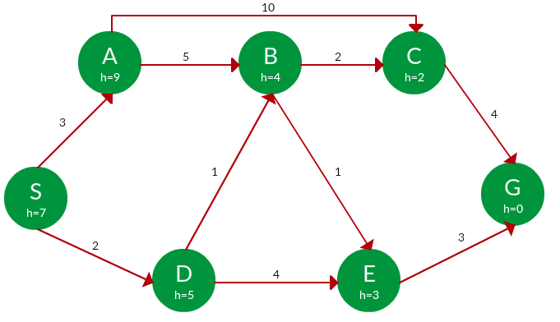

Example 2: A* Tree (Best First) Search
$$f(x) = g(x) + h(x)$$
g(x) = backward
h(x) = forward
Question. Find the path to reach from S to G using A* search.
PATH h(x) g(x) f(x)
S 7 0 7
S -> A 9 3 12
S -> D ✔ 5 2 7
S -> D -> B ✔ 4 2 + 1 = 3 7
S -> D -> E 3 2 + 4 = 6 9
S -> D -> B -> C ✔ 2 3 + 2 = 5 7
S -> D -> B -> E ✔ 3 3 + 1 = 4 7
S -> D -> B -> C -> G 0 5 + 4 = 9 9
S -> D -> B -> E -> G ✔ 0 4 + 3 = 7 7
Path: S -> D -> B -> E -> G
Cost: 7
Solution. Starting from S, the algorithm computes g(x) + h(x) for all nodes in the fringe at each step, choosing the node with the lowest sum. The entire working is shown in the table below.
Note that in the fourth set of iteration, we get two paths with equal summed cost f(x), so we expand them both in the next set. The path with lower cost on further expansion is the chosen path.
Selesaikan menggunakan model tabel seperti pada Example 1

Slide 33
Heuristic Searching 3.
Branch and Bound Search Algorithm https://www.geeksforgeeks.org/job-assignment-problem-using-branch-and-bound/
Branch and bound is an algorithm design paradigm which is generally used for solving combinatorial optimization problems.
The selection rule for the next node in BreadthFS and DepthFS is “blind”. i.e., the selection rule does not give any preference to a node that has a very good chance of getting the search to an answer node quickly.
The search for an optimal solution can often be speeded by using an “intelligent” ranking function, also called an approximate cost function to avoid searching in sub-trees that do not contain an optimal solution.
It is similar to BreadthFS-like search but with one major optimization.
Instead of following FIFO order, we choose a live node with least cost.
We may not get optimal solution by following node with least promising cost, but it will provide very good chance of getting the search to an answer node quickly.

Slide 34
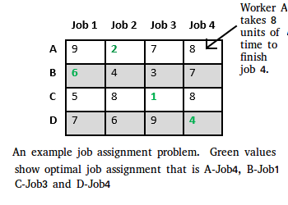
Job Assignment Problem using Branch And Bound https://www.geeksforgeeks.org/job-assignment-problem-using-branch-and-bound/
Let there be N workers and N jobs.
Any worker can be assigned to perform any job, incurring some cost that may vary depending on the work-job assignment.
GOAL: It is required to perform all jobs by assigning exactly one worker to each job and exactly one job to each agent in such a way that the total cost of the assignment is minimized.
A-Job2,

Slide 35
There are two approaches to calculate the cost function
For each worker, we choose job with minimum cost from list of unassigned jobs (take minimum entry from each row).
For each job, we choose a worker with lowest cost for that job from list of unassigned workers (take minimum entry from each column).

Slide 36
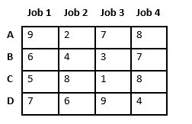
The first approach is followed:
For each worker, we choose job with minimum cost from list of unassigned jobs (take minimum entry from each row).
Let’s take below example and try to calculate promising cost when Job 2 is assigned to worker A.

Slide 37
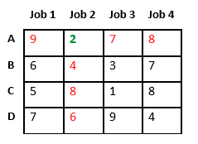
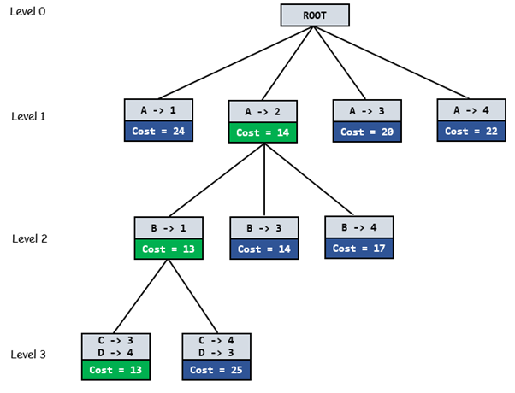
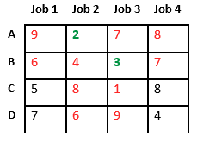
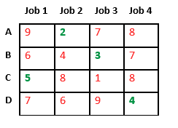
Since Job 2 is assigned to worker A (marked in green), cost becomes 2 and Job 2 and worker A becomes unavailable (marked in red).
Now we assign job 3 to worker B as it has minimum cost from list of unassigned jobs. Cost becomes 2 + 3 = 5 and Job 3 and worker B also becomes unavailable.
Finally, job 1 gets assigned to worker C as it has minimum cost among unassigned jobs and job 4 gets assigned to worker C as it is only Job left. Total cost becomes 2 + 3 + 5 + 4 = 14.
Below diagram shows complete search space diagram showing optimal solution path in green.
Cost = 9
Cost = 2
Cost = 7
Cost = 8
Cost = 6
Cost = 3
Cost = 7
C -> 1
D -> 4
C -> 4
D -> 1
Cost = 9
Cost = 15

Slide 38
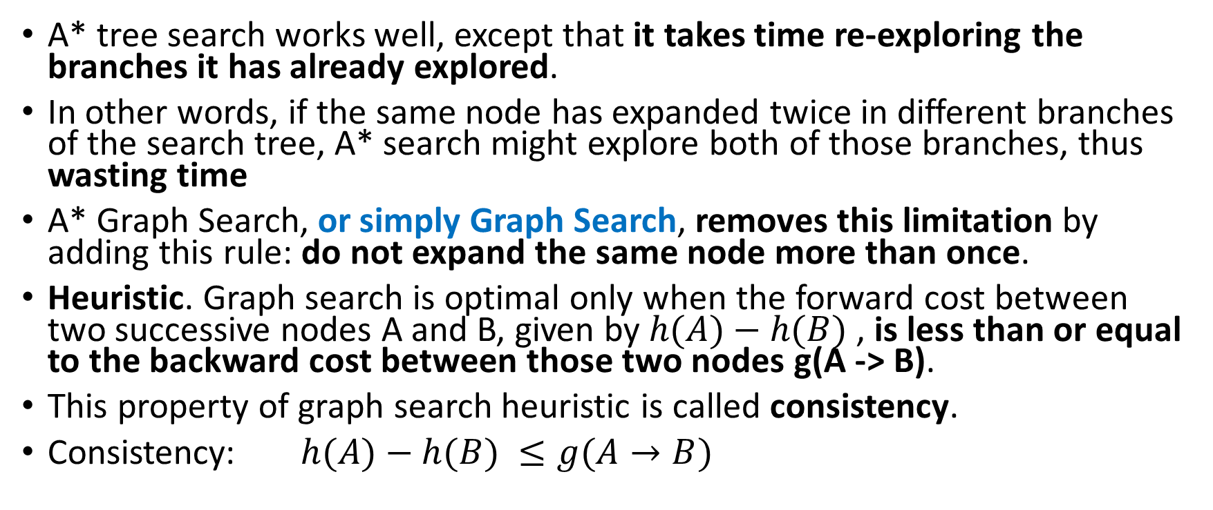
Heuristic Searching 3:
A* Graph Search Algorithm https://www.geeksforgeeks.org/search-algorithms-in-ai/
A* tree search works well, except that it takes time re-exploring the branches it has already explored.
In other words, if the same node has expanded twice in different branches of the search tree, A* search might explore both of those branches, thus wasting time
A* Graph Search, or simply Graph Search, removes this limitation by adding this rule: do not expand the same node more than once.
Heuristic. Graph search is optimal only when the forward cost between two successive nodes A and B, given by $h(A)−h(B)$, is less than or equal to the backward cost between those two nodes g(A -> B).
This property of graph search heuristic is called consistency.
Consistency: $h(A)−h(B) ≤g(A→B)$

Slide 39
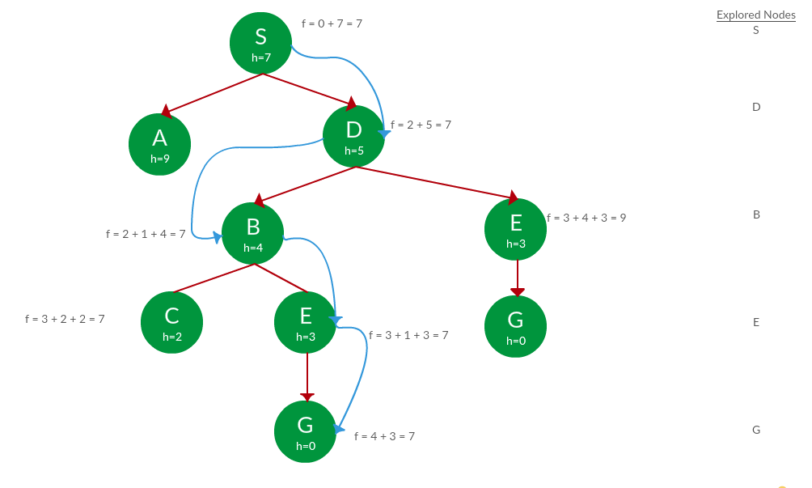
Example of A* Graph Search
Solution. We solve this question pretty much the same way we solved last question, but in this case, we keep a track of nodes explored so that we don’t re-explore them.
Question. Use graph search to find path from S to G in the following graph.
Path: S -> D -> B -> E -> G
Cost: 7

Slide 40
Heuristic Searching 4:
Hill Climbing
Hill climbing search is a local search problem.
The purpose of the hill climbing search is to climb a hill and reach the topmost peak/point of that hill.
It is based on the heuristic search technique where the person who is climbing up on the hill estimates the direction which will lead him to the highest peak.

Slide 41
Hill Climbing
Metode ini hampir sama dengan metode Generate and Test, hanya saja proses pengujian dilakukan dengan menggunakan fungsi heuristic.
Pembangkitan keadaan berikutnya tergantung pada feedback dari prosedur pengetesan.
Tes yang berupa fungsi heuristic ini akan menunjukkan seberapa baiknya nilai terkaan yang diambil terhadap keadaan-keadaan lainnya yang mungkin.

Slide 42
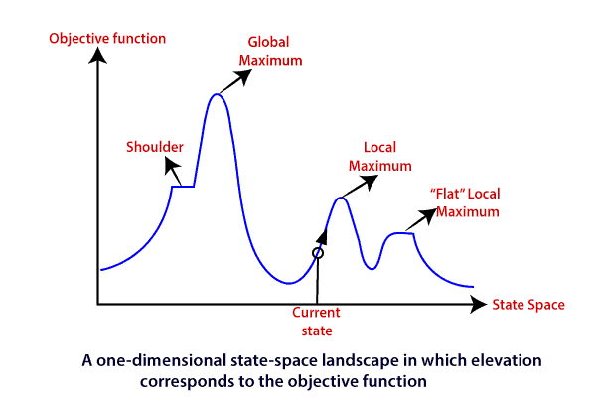
State-space Landscape of Hill climbing algorithm
State space diagram is a graphical representation of the set of states our search algorithm can reach vs the value of our objective function(the function which we wish to maximize).
X-axis : denotes the state space, i.e., states or configuration our algorithm may reach.
Y-axis : denotes the values of objective function corresponding to a particular state.
The best solution will be that state space where objective function has maximum value(global maximum).
The topographical regions.
The concept of hill climbing algorithm, consider the below landscape representing the goal state/peak and the current state of the climber
Global Maximum: It is the highest point on the hill, which is the goal state.
Local Maximum: It is the peak higher than all other peaks but lower than the global maximum.
Flat local maximum: It is the flat area over the hill where it has no uphill or downhill. It is a saturated point of the hill.
Shoulder: It is also a flat area where the summit is possible.
Current state: It is the current position of the person.
https://www.tutorialandexample.com/hill-climbing-algorithm/

Slide 43
The topographical regions
The concept of hill climbing algorithm, consider the below landscape representing the goal state/peak and the current state of the climber
Global Maximum: It is the highest point on the hill, which is the goal state.
Local Maximum: It is the peak higher than all other peaks but lower than the global maximum.
Flat local maximum: It is the flat area over the hill where it has no uphill or downhill. It is a saturated point of the hill.
Shoulder: It is also a flat area where the summit is possible.
Current state: It is the current position of the person.

Slide 44
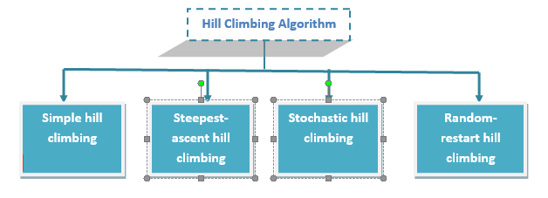
Types of Hill climbing search algorithm

Slide 45
Types of Hill Climbing
1. Simple Hill Climbing
Simple hill climbing is the simplest way to implement a hill-climbing algorithm.
It only evaluates the neighbour node state at a time and selects the first one which optimizes current cost and set it as a current state.
It only checks it’s one successor state, and if it finds better than the current state, then move else be in the same state.
2. Steepest-Ascent hill climbing
The steepest-Ascent algorithm is a variation of the simple hill-climbing algorithm.
This algorithm examines all the neighbouring nodes of the current state and selects one neighbour node which is closest to the goal state.
This algorithm consumes more time as it searches for multiple neighbours.
3. Stochastic hill climbing
Stochastic hill climbing does not examine for all its neighbours before moving.
Rather, this search algorithm selects one neighbour node at random and evaluate it as a current state or examine another state.

Slide 46
Simple hill climbing search
Simple hill climbing is the simplest technique to climb a hill.
The task is to reach the highest peak of the mountain.
The movement of the climber depends on his move/steps.
If he finds his next step better than the previous one, he continues to move else remain in the same state.
This search focus only on his previous and next step.

Slide 47
Steepest-Ascent hill climbing
Step 1: Evaluate the initial state, if it is goal state then return success and stop, else make the current state as your initial state.
Step 2: Loop until a solution is found or the current state does not change.
  Let S be a state such that any successor of the current state will be better than it.
  For each operator that applies to the current state;
    Apply the new operator and generate a new state.
    Evaluate the new state.
    If it is goal state, then return it and quit, else compare it to the S.
    If it is better than S, then set new state as S.
    If the S is better than the current state, then set the current state to S.
Step 5: Exit.

Slide 48
Simple hill climbing algorithm
{ It examines the neighboring nodes one by one and selects the first neighboring node which optimizes the current cost as next node.}
Step 1: Evaluate the initial state, if it is goal state then return success and Stop.
Step 2: Loop Until a solution is found or there is no new operator left to apply.
Step 3: Select and apply an operator to the current state.
Step 4: Check new state:
  If it is goal state, then return success and quit.
  else if it is better than the current state then assign new state as a current state.
  else if not better than the current state, then return to step 2.
Step 5: Exit.

Slide 49
Limitations of Hill climbing algorithm
Hill climbing algorithm is a fast and furious approach.
It finds the solution state rapidly because it is quite easy to improve a bad state.
But, there are some limitations of this search:
  Local Maxima
  Plateau
  Ridges

Slide 50
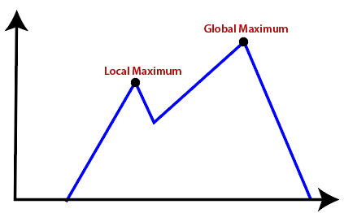
Local Maxima
It is that peak of the mountain which is highest than all its neighboring states but lower than the global maxima.
It is not the goal peak because there is another peak higher than it.
Solution:
  Backtracking technique can be a solution of the local maximum in state space landscape.
  Create a list of the promising path so that the algorithm can backtrack the search space and explore other paths as well.

Slide 51
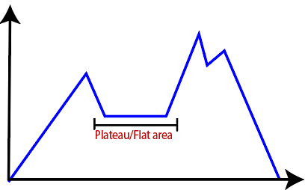
Plateau
It is a flat surface area where no uphill exists.
It becomes difficult for the climber to decide that in which direction he should move to reach the goal point.
Sometimes, the person gets lost in the flat area.
Solution:
  Take big steps or very little steps while searching, to solve the problem.
  Randomly select a state which is far away from the current state so it is possible that the algorithm could find non-plateau region.

Slide 52
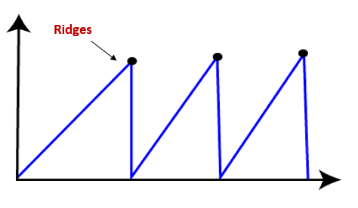
Ridges
It is a challenging problem where the person finds two or more local maxima of the same height commonly.
It becomes difficult for the person to navigate the right point and stuck to that point itself.
Solution:
  by using of bidirectional search, or
  by moving in different directions

Slide 53
Referensi
https://users.cs.cf.ac.uk/Dave.Marshall/AI2/node22.html#figdep_tree
https://www.geeksforgeeks.org/search-algorithms-in-ai/
https://www.javatpoint.com/ai-uninformed-search-algorithms
https://syifamss.wordpress.com/2017/12/08/metode-pencarian-buta-blind-search-metode-pencarian-heuristik/
http://alfanfikri27.blogspot.com/2017/12/metode-blind-search-heuristik.html
https://fitrahadiarief.wordpress.com/2017/12/09/metode-pencarian-buta-blind-search-method-dan-metode-pencarian-heuristik/

